Slide 1


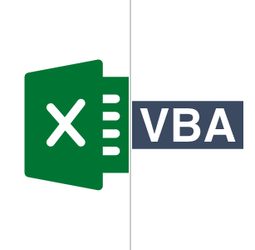
SQL Programming
Project

Slide 2
Submitted by
Mohammad Monjur-E-Elahi
Course: SQL Programming [DSA03]
Program: Data Science and Application - Advanced Diploma [6060]
Metro College of Technology
Date: 01 September, 2021

Slide 3
Phase 01
1. Create a database for a banking application called “Bank”. [Basic]
2. Create all the tables mentioned in the database diagram. [Moderate]
3. Create all the constraints based on the database diagram. [Advanced]
4. Insert at least 5 rows in each table. [Basic]

Slide 4
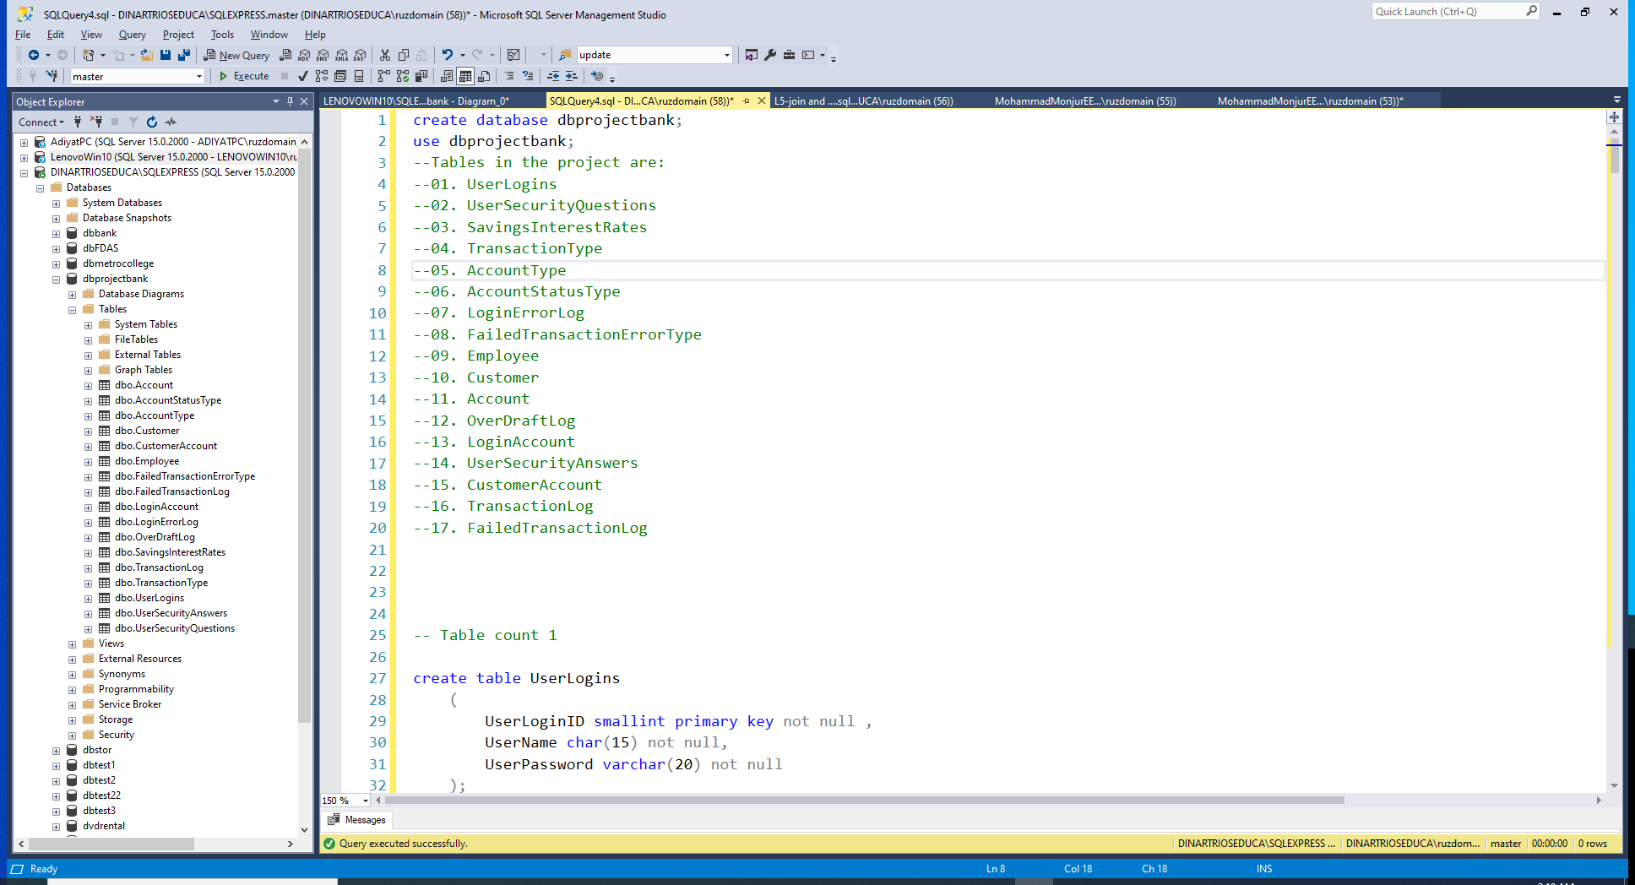
Parents Tables are taken care of before the child table

Slide 5
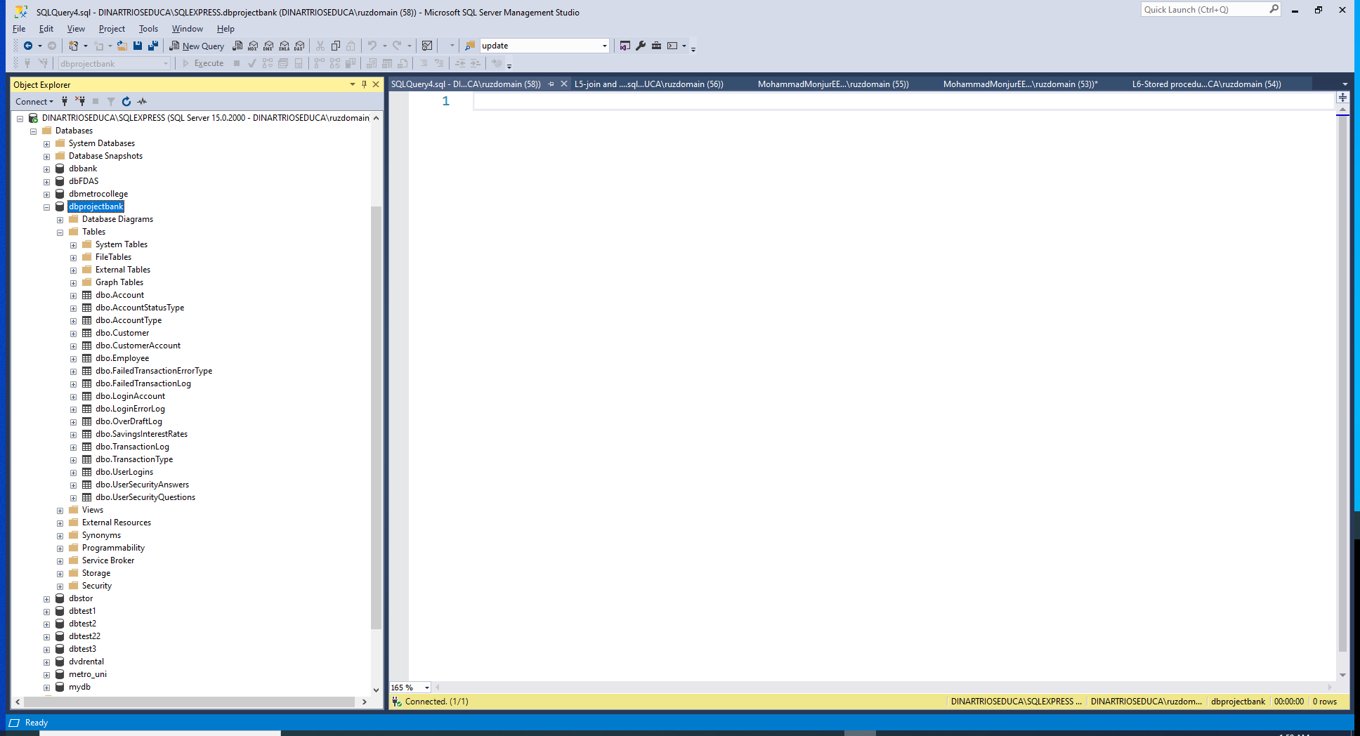

Slide 6
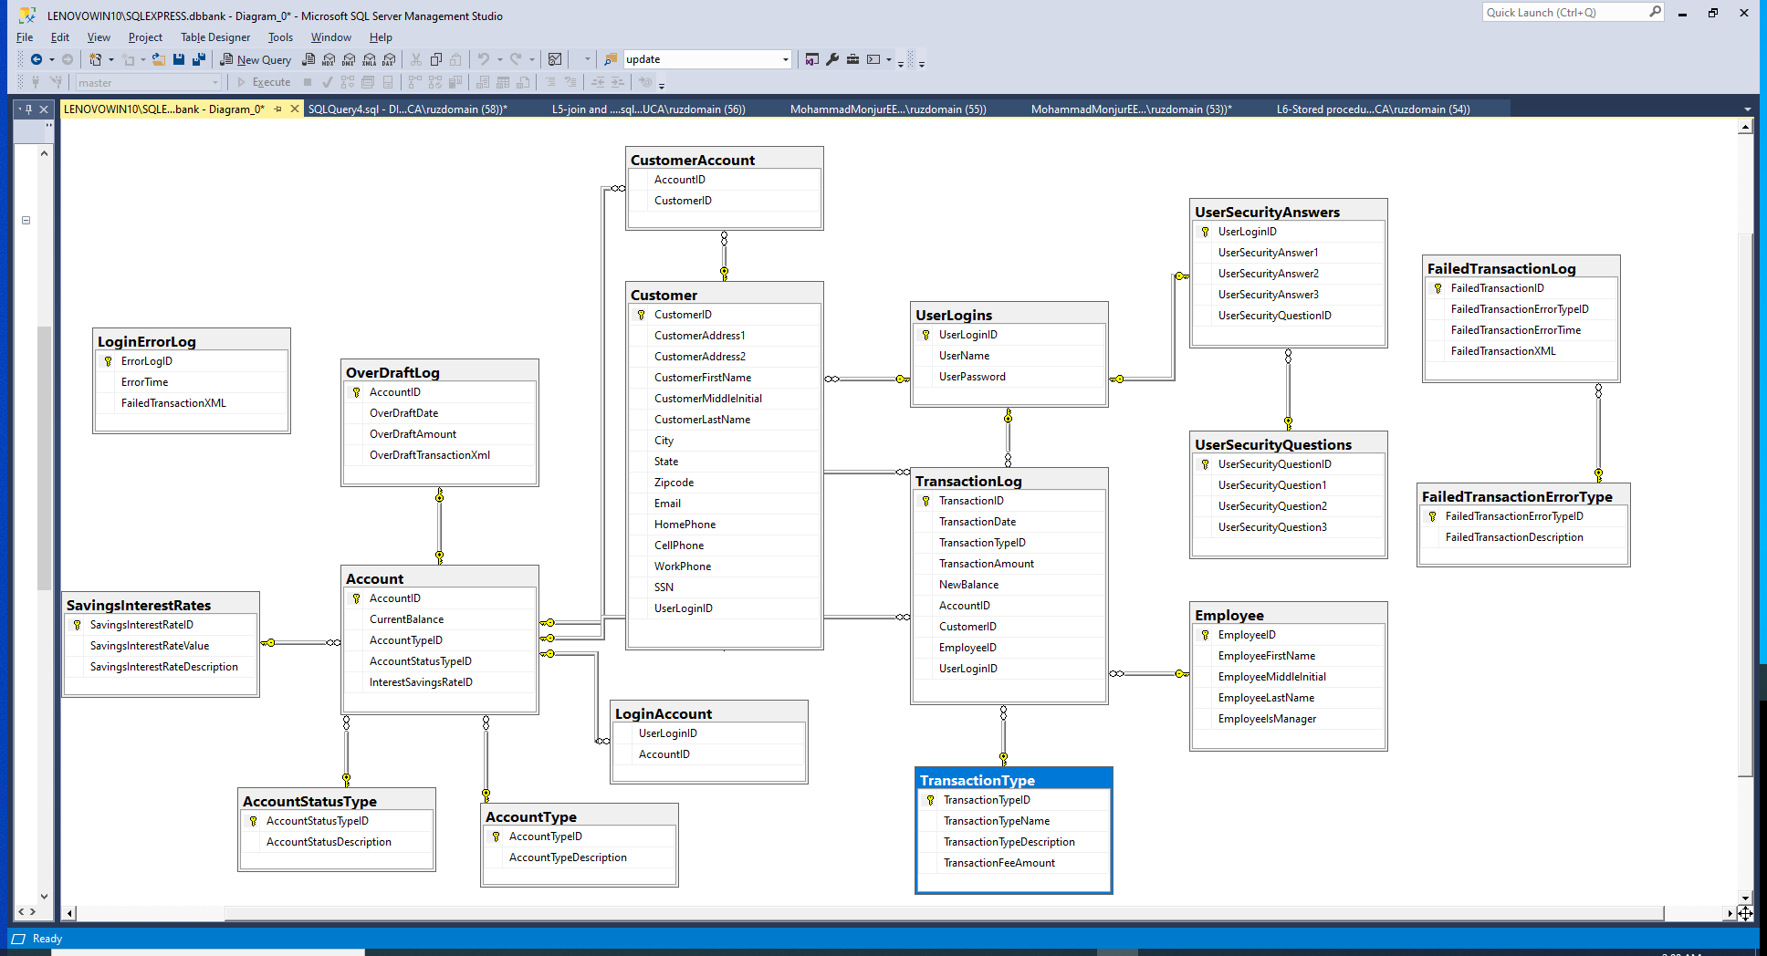

Slide 7
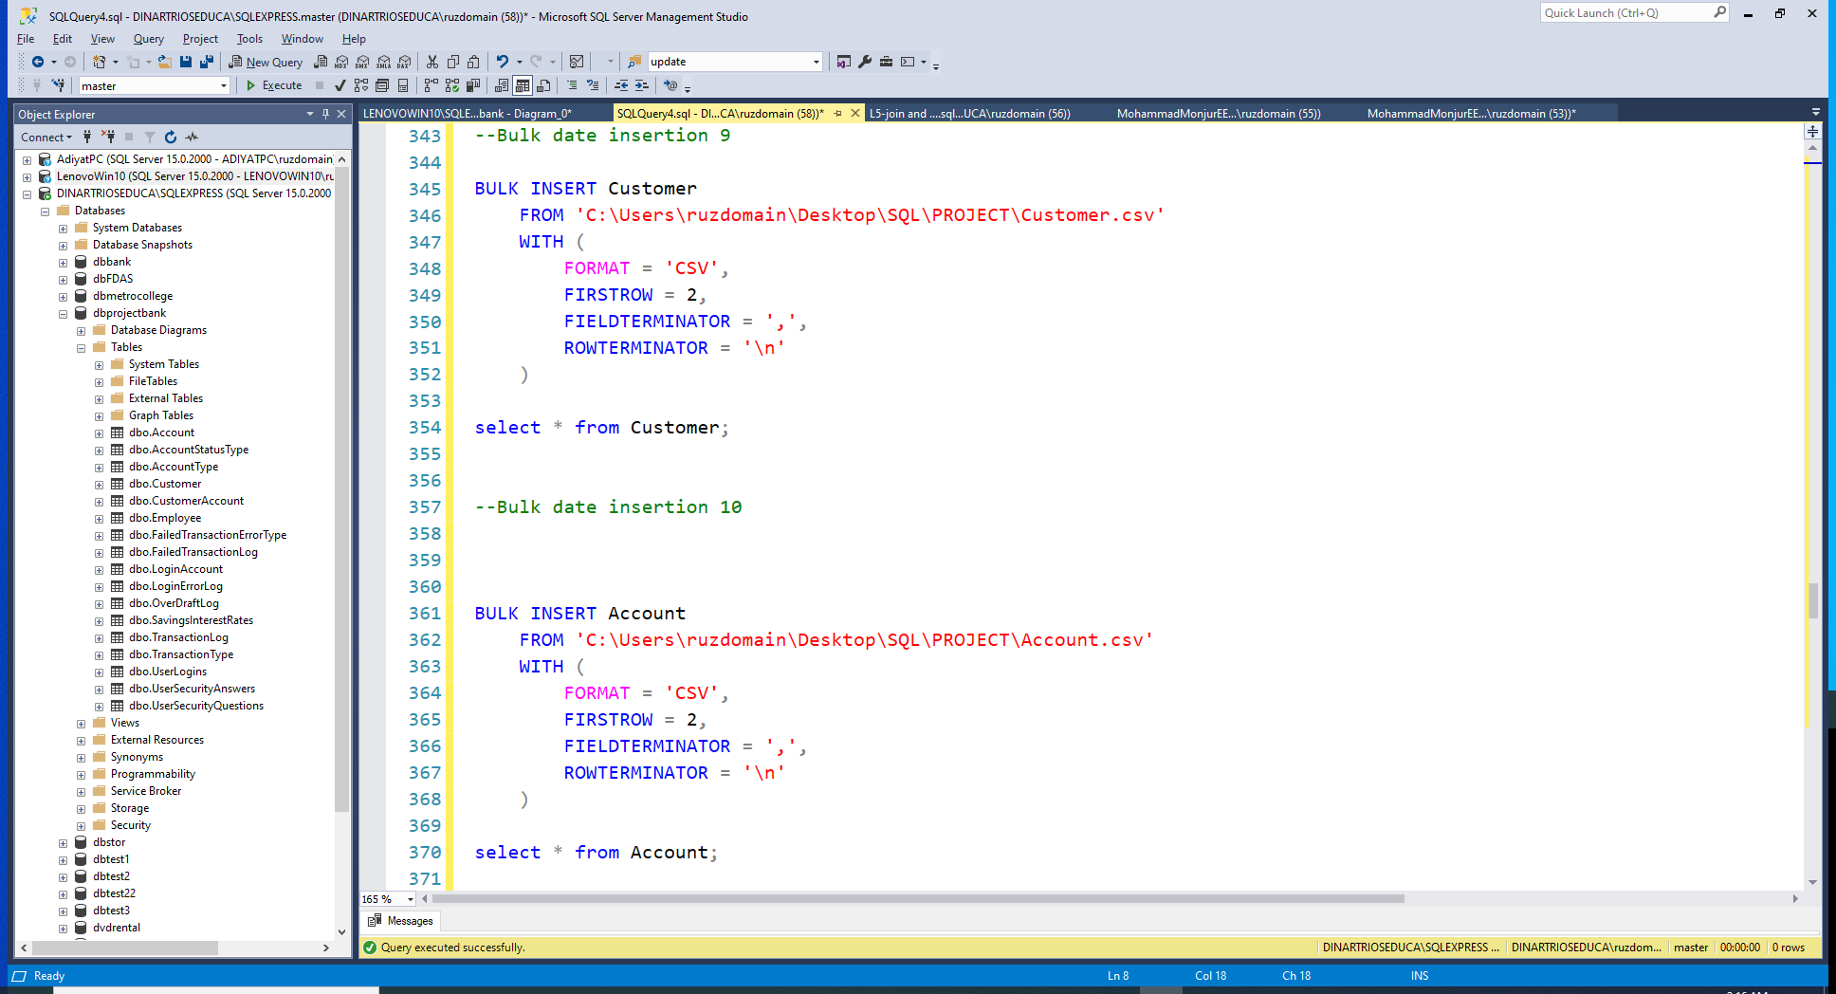
14 out of 17 tables are created by bulk insert using .csv files

Slide 8
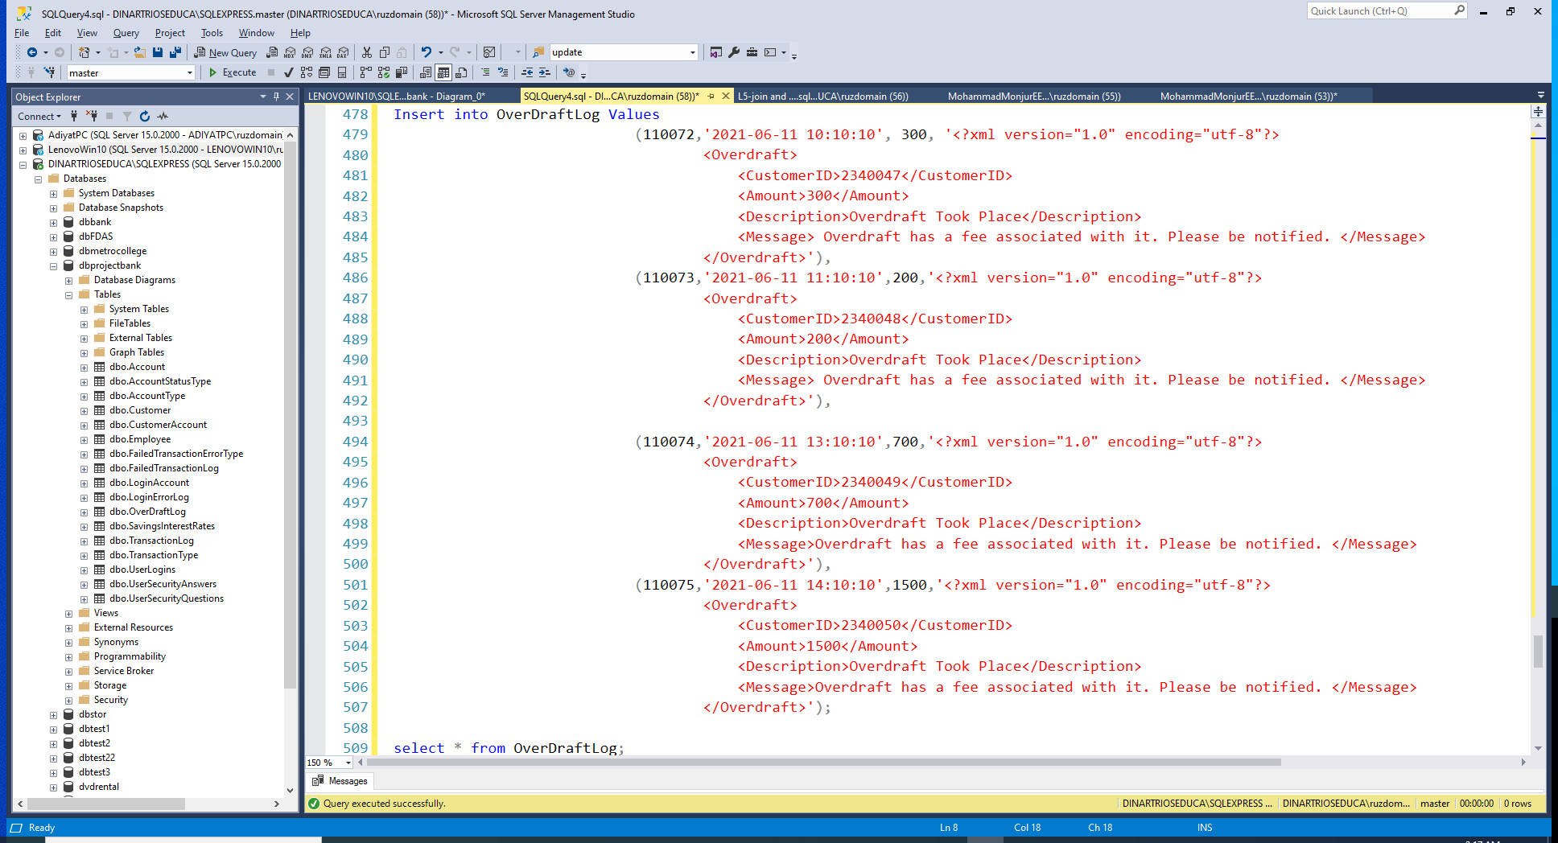
3 out of 17 tables are created by Insert Into command

Slide 9
ORDER | TABLE NAME | ROWS INSERTED
1 | UserLogins | 50
2 | UserSecurityQuestions | 05
3 | SavingsInterestRates | 04
4 | TransactionType | 06
5 | AccountType | 02
6 | AccountStatusType | 06
7 | LoginErrorLog | 05
8 | FailedTransactionErrorType | 02
9 | Employee | 05
10 | Customer | 50
11 | Account | 75
12 | OverDraftLog | 04
13 | LoginAccount | 75
14 | UserSecurityAnswers | 50
15 | CustomerAccount | 75
16 | TransactionLog | 75
17 | FailedTransactionLog | 04
Number of observations of the tables

Slide 10
Phase 02
THANKS
01. Create a view to get all customers with checking account from ON province. [Moderate]
02. Create a view to get all customers with total account balance (including interest rate) greater than 5000. [Advanced]
03. Create a view to get counts of checking and savings accounts by customer. [Moderate]
04. Create a view to get any particular user’s login and password using AccountId. [Moderate]
05. Create a view to get all customers’ overdraft amount. [Moderate]
06. Create a stored procedure to add “User_” as a prefix to everyone’s login (username). [Moderate]
07. Create a stored procedure that accepts AccountId as a parameter and returns customer’s full name. [Advanced]
08. Create a stored procedure that returns error logs inserted in the last 24 hours. [Advanced]
09. Create a stored procedure that takes a deposit as a parameter and updates CurrentBalance value for that particular account. [Advanced]
10. Create a stored procedure that takes a withdrawal amount as a parameter and updates

Slide 11
Phase 02: Q01
Create a view to get all customers with checking account from ON province. [Moderate]
LIST

Slide 12
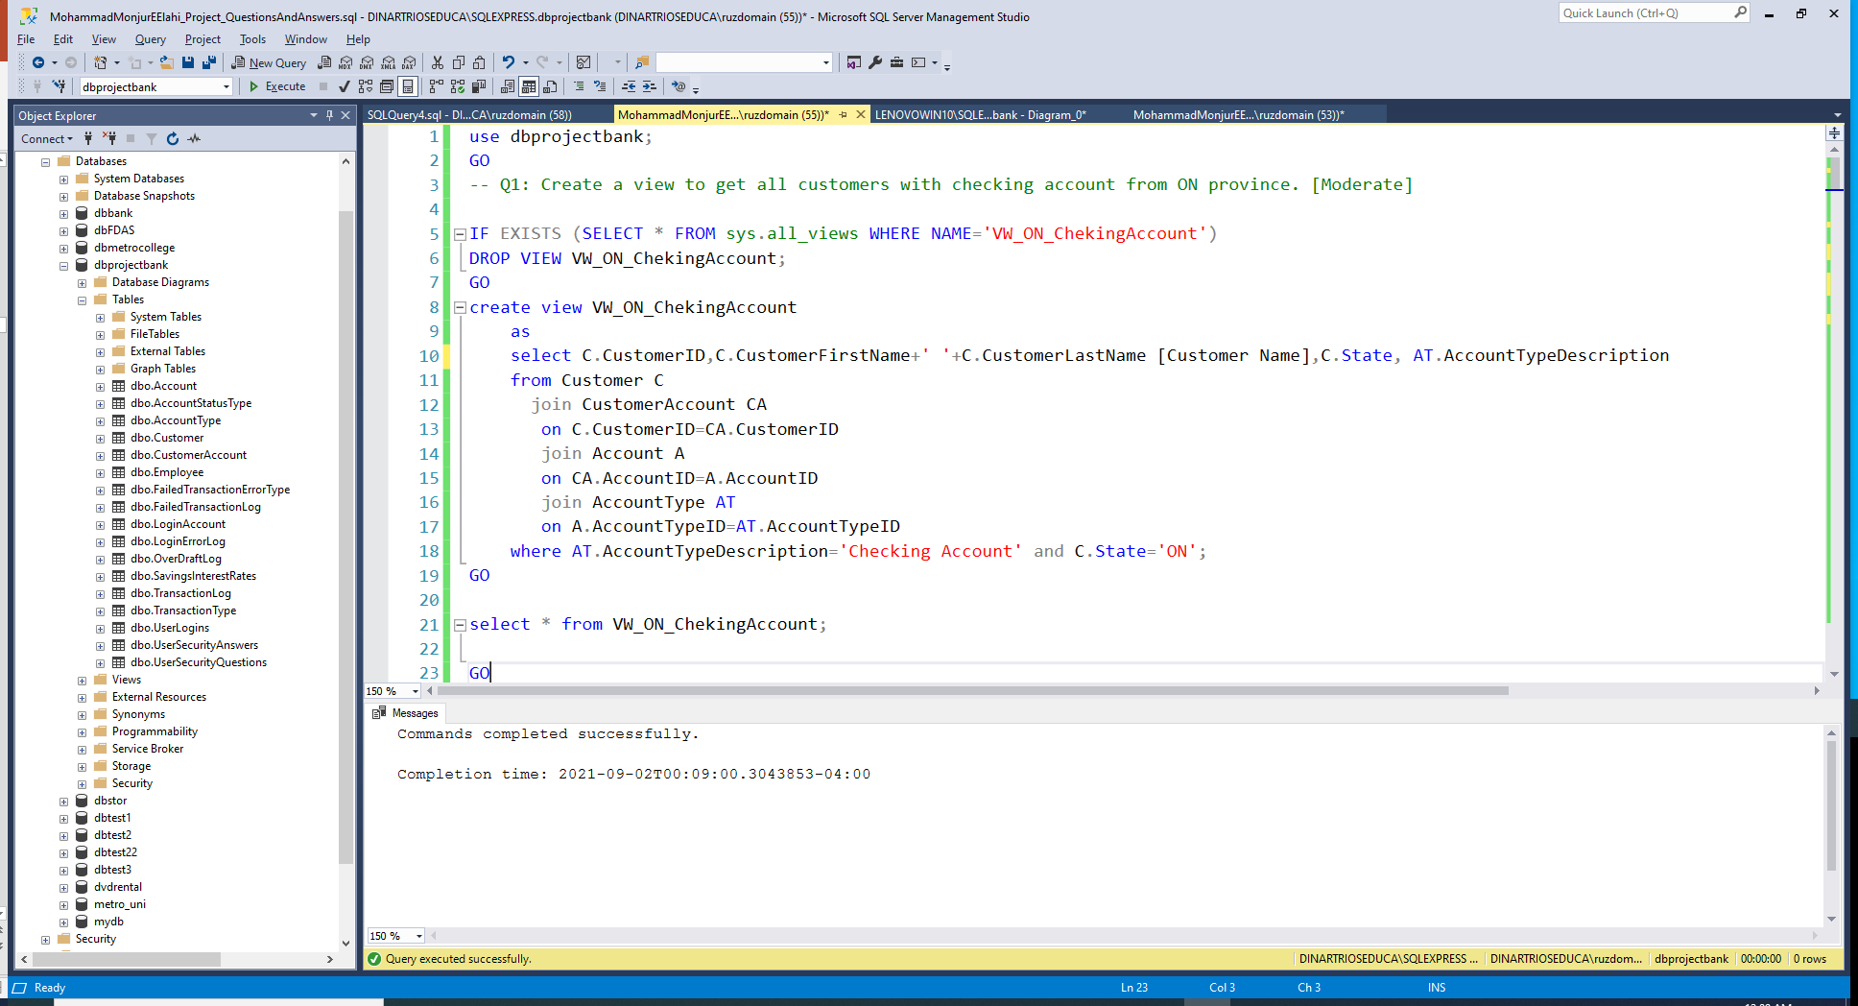

Slide 13
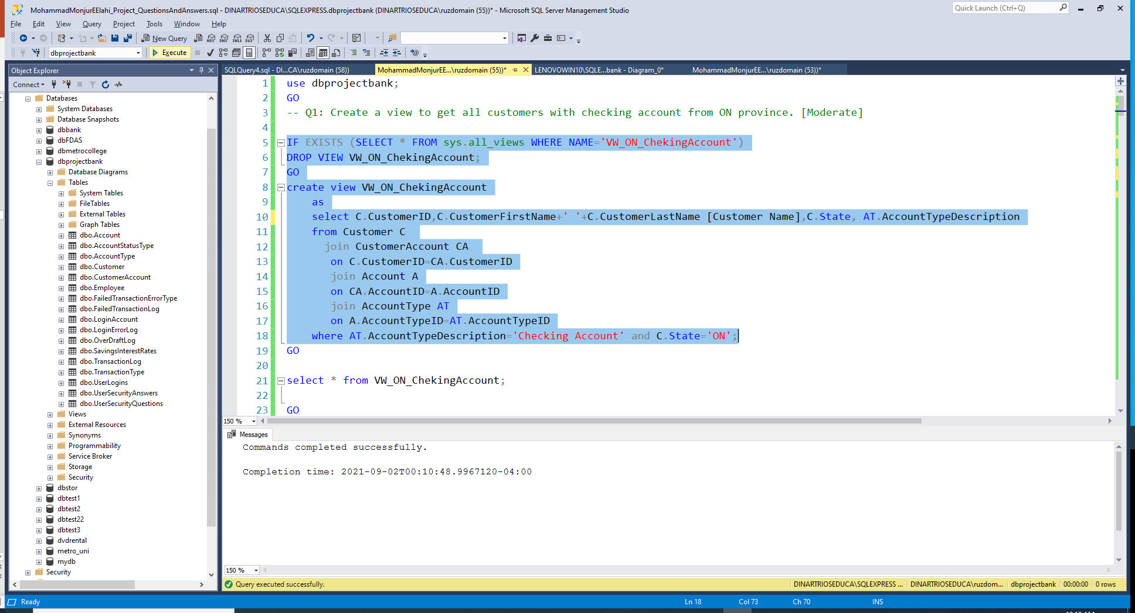

Slide 14
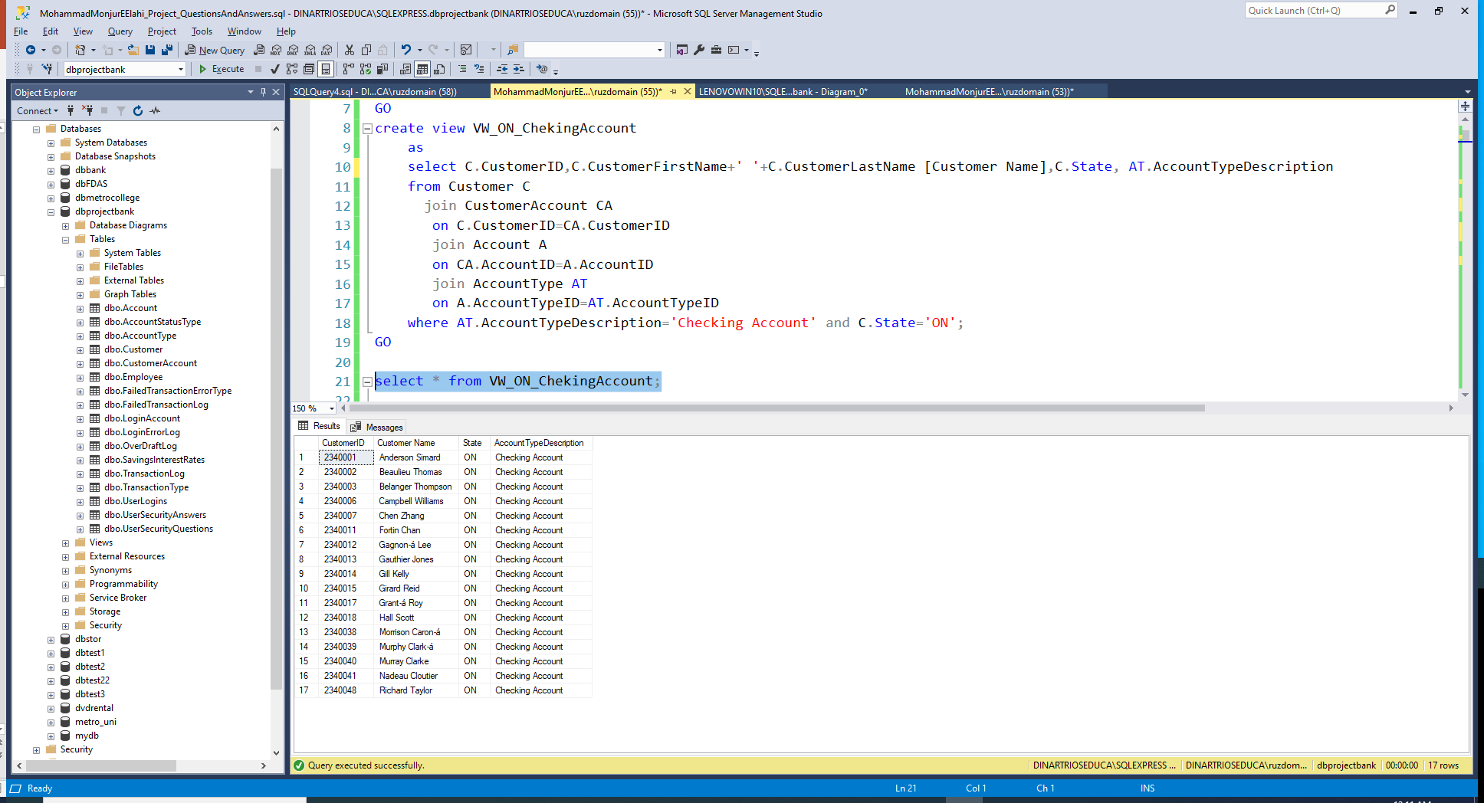
LIST

Slide 15
Phase 02: Q02
Create a view to get all customers with total account balance (including interest rate) greater than 5000. [Advanced]
LIST

Slide 16
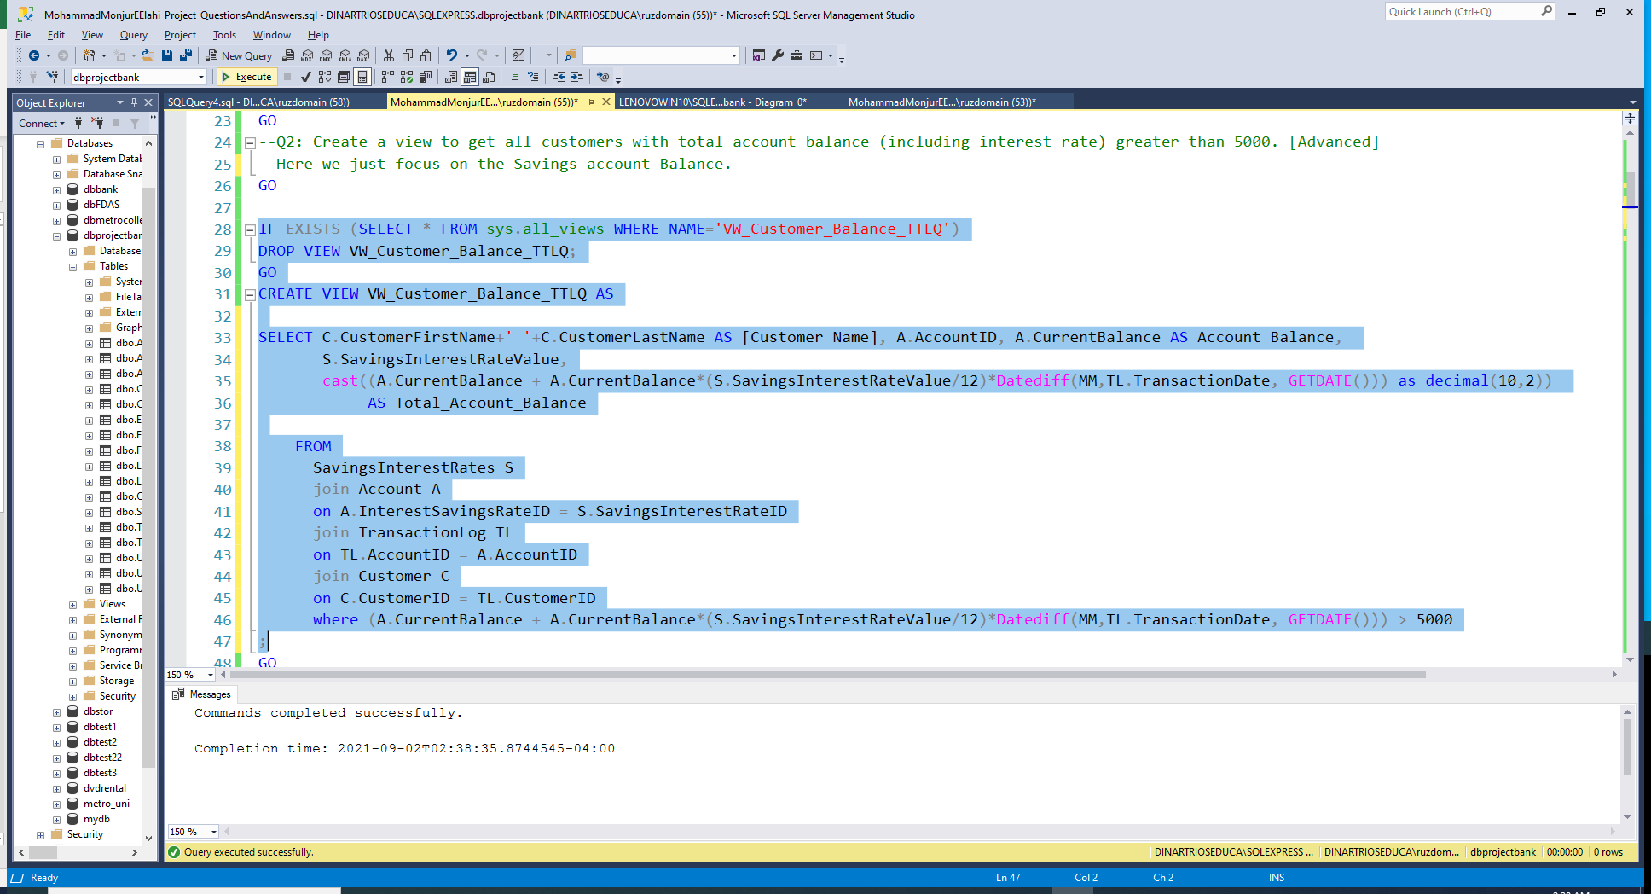

Slide 17
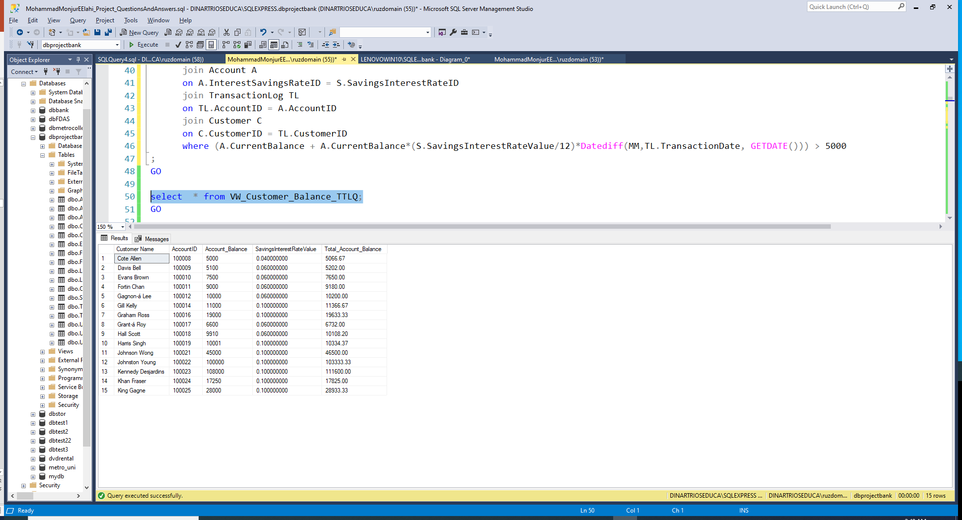
LIST

Slide 18
LIST

Slide 19
Phase 02: Q03
Create a view to get counts of checking and savings accounts by customer. [Moderate]
LIST

Slide 20
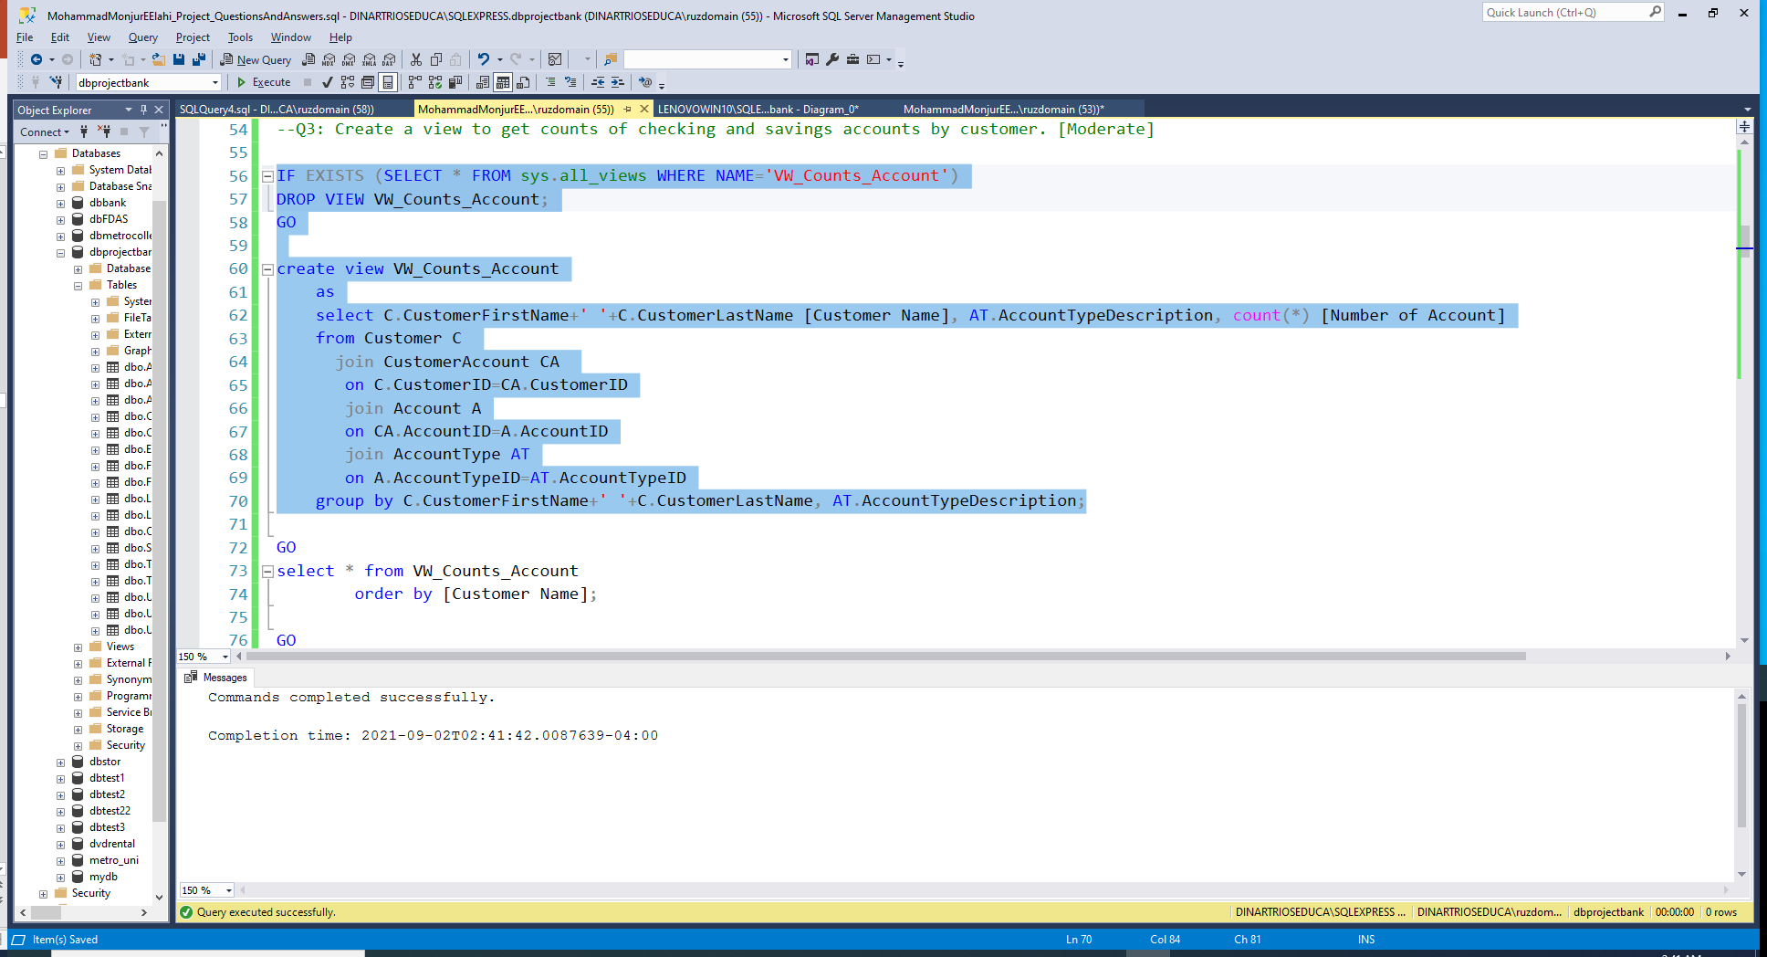

Slide 21
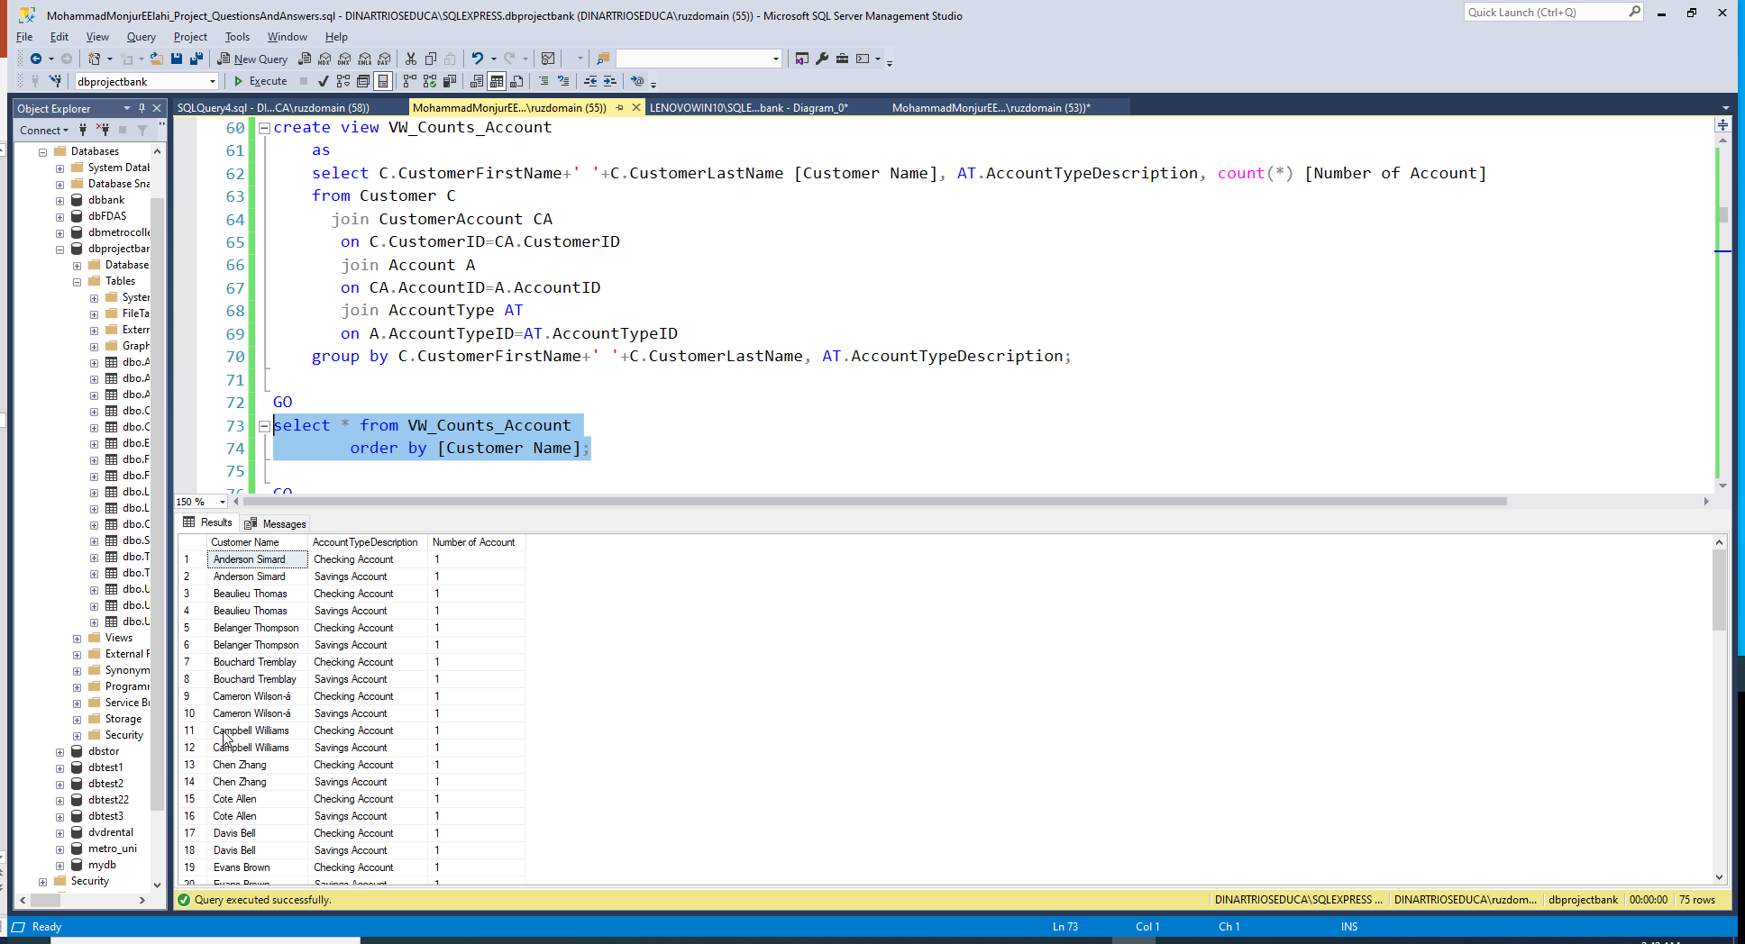

Slide 22
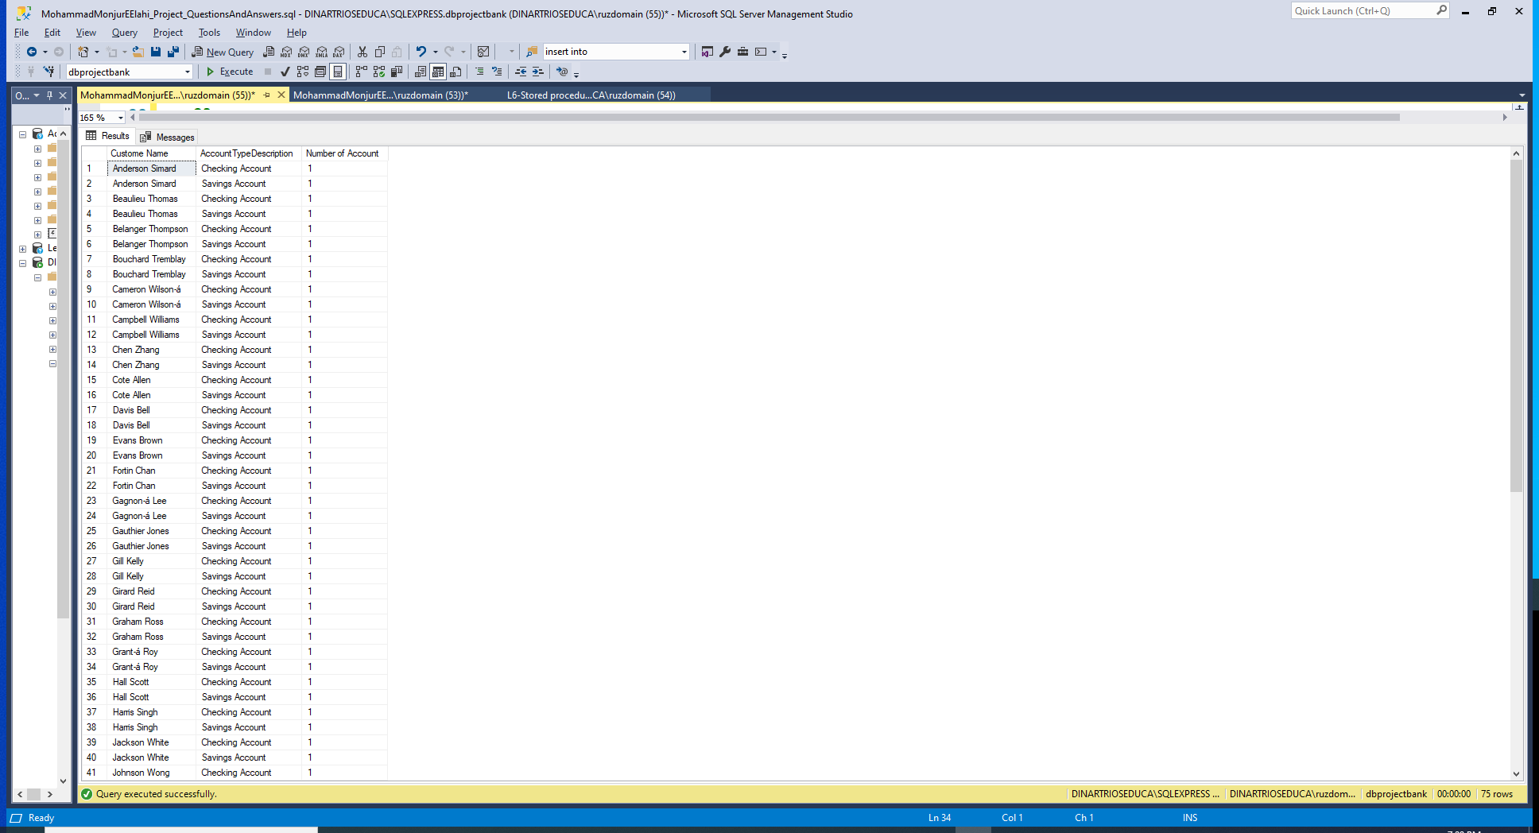

Slide 23
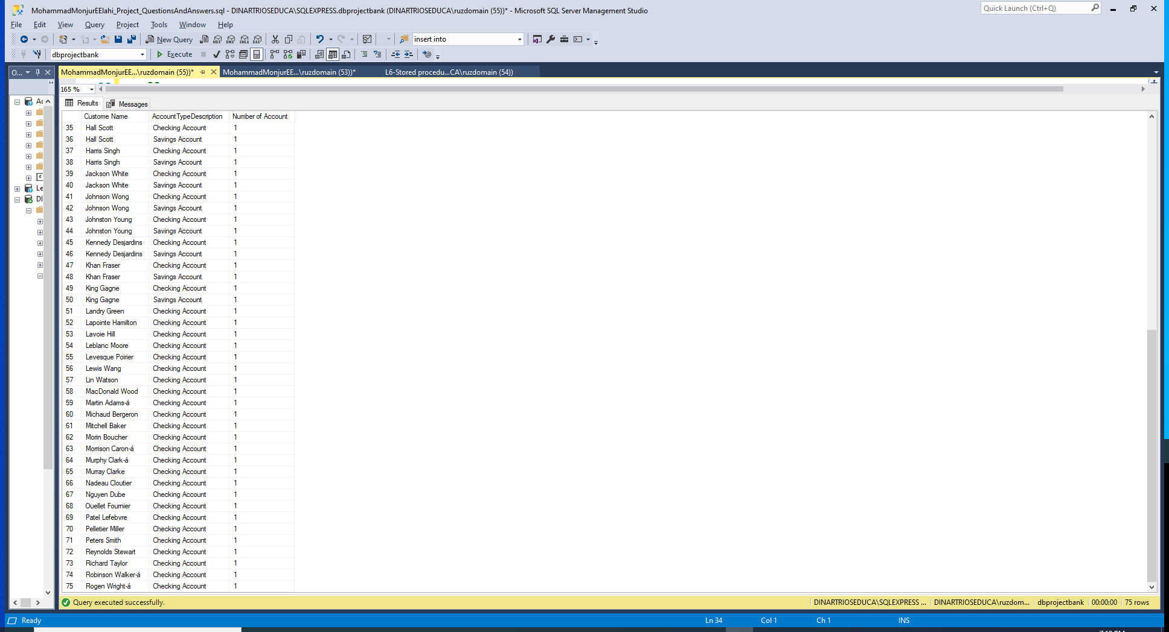
LIST

Slide 24
Phase 02: Q04
Create a view to get any particular user’s login and password using AccountId. [Moderate]
LIST

Slide 25
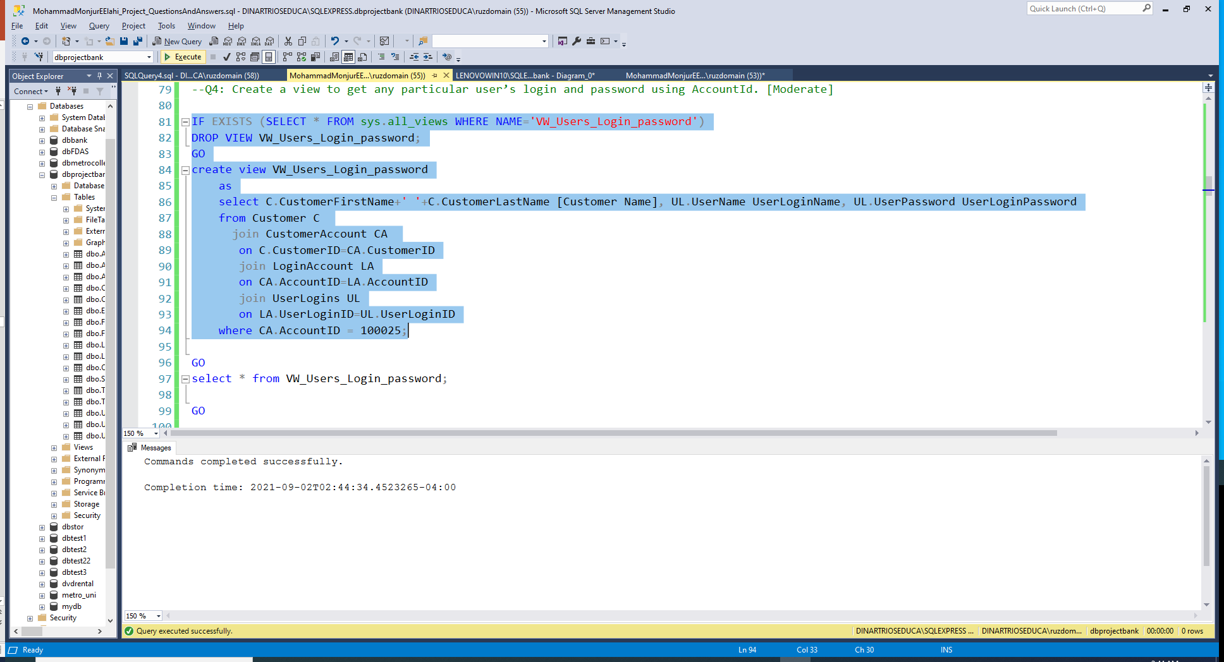

Slide 26
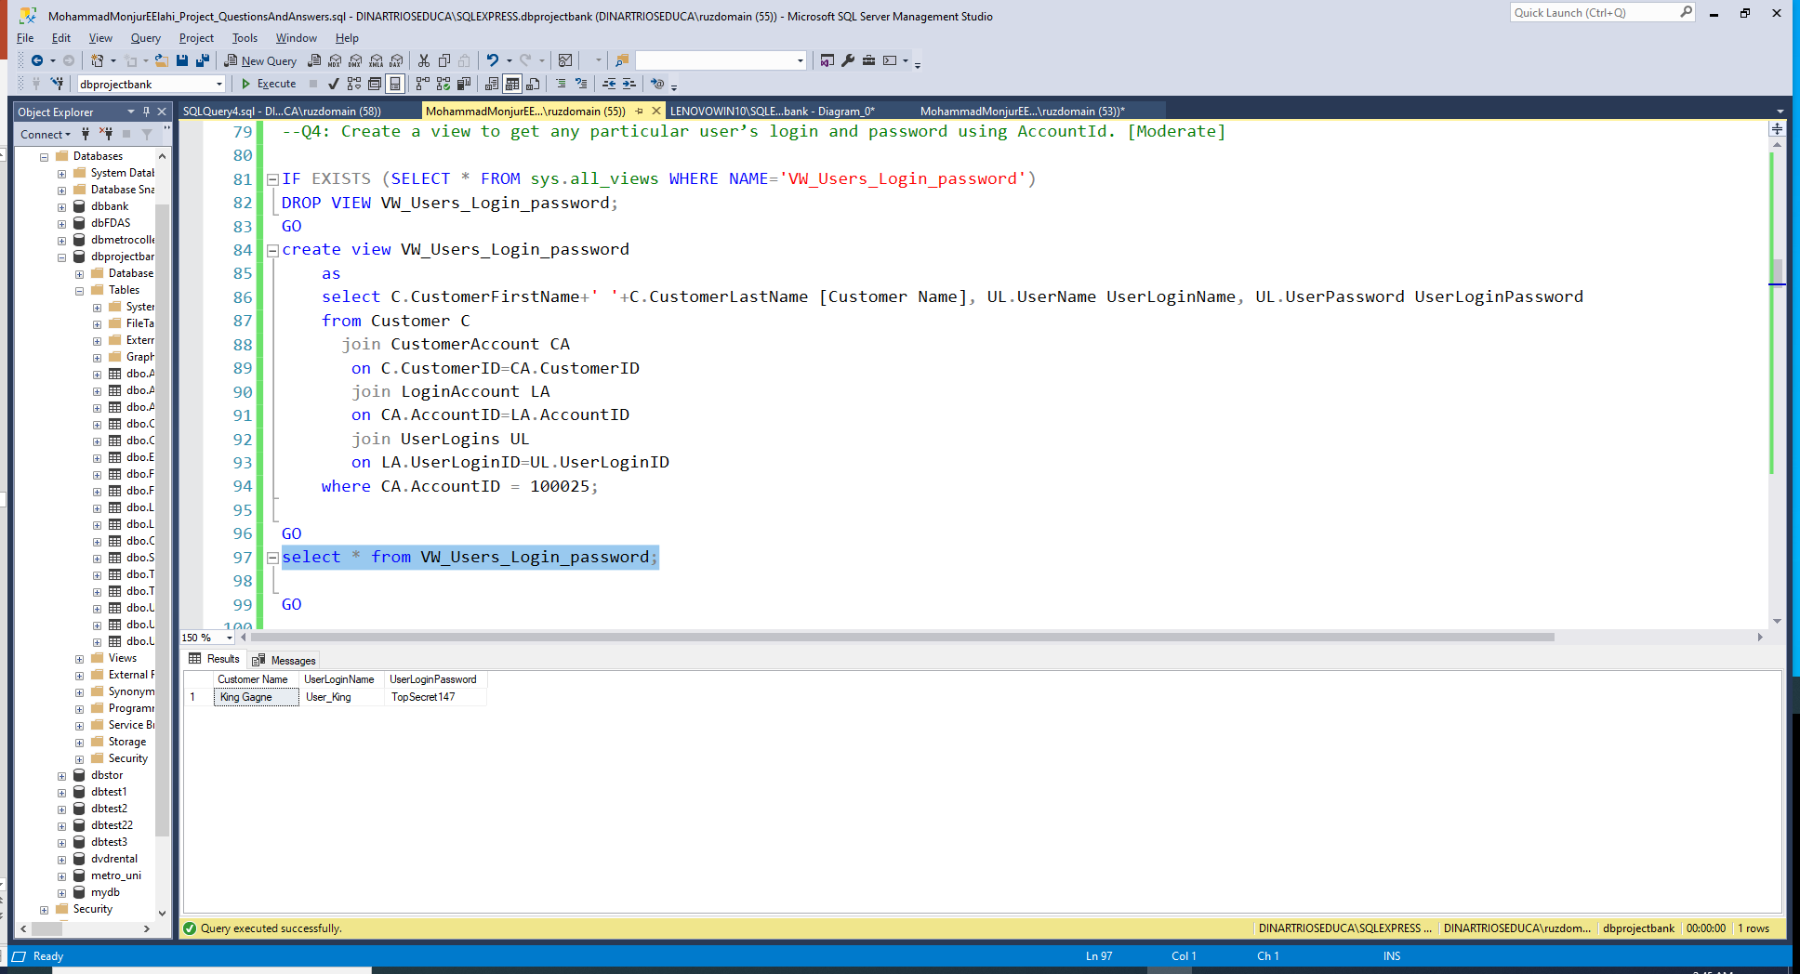
LIST

Slide 27
Phase 02: Q05
Create a view to get all customers’ overdraft amount. [Moderate]
LIST

Slide 28
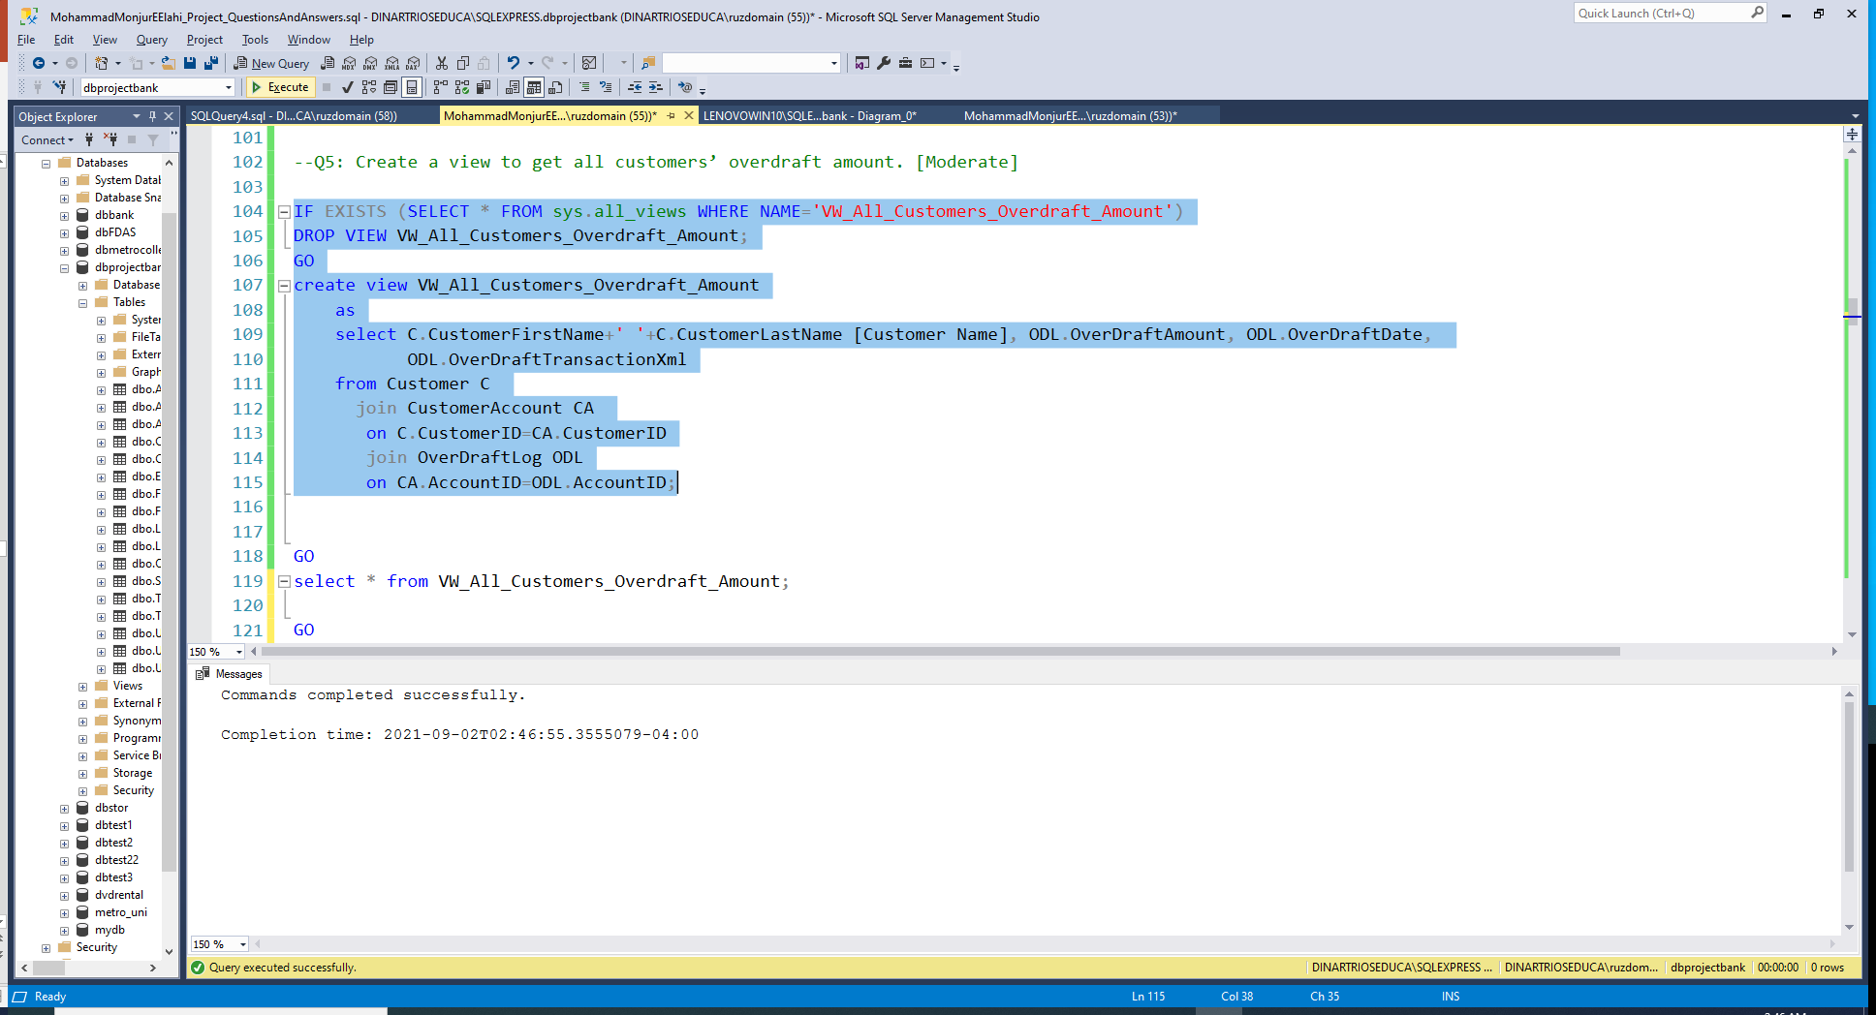

Slide 29
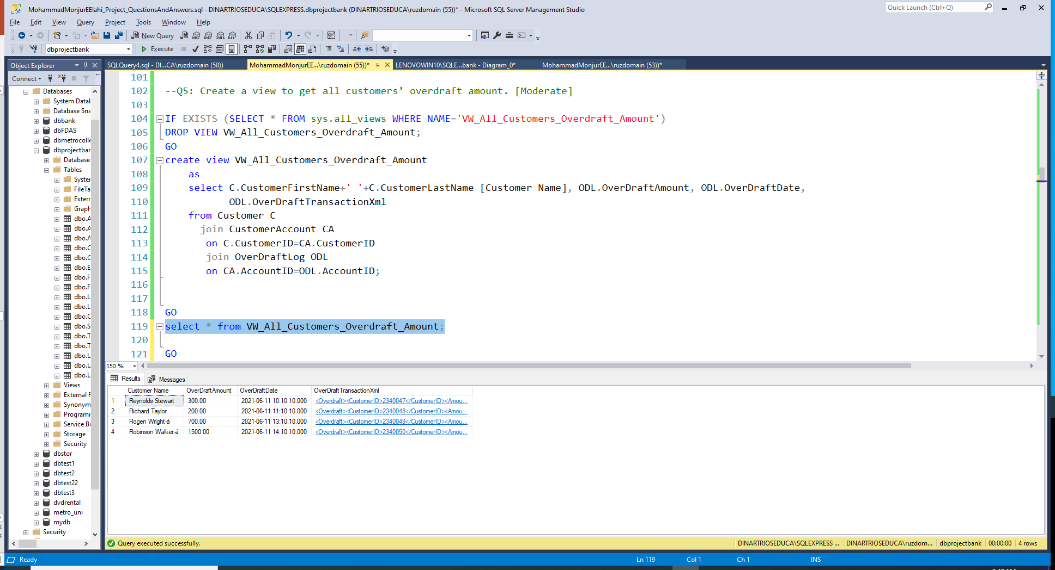
LIST

Slide 30
Phase 02: Q06
Create a stored procedure to add “User_” as a prefix to everyone’s login (username). [Moderate]
LIST

Slide 31
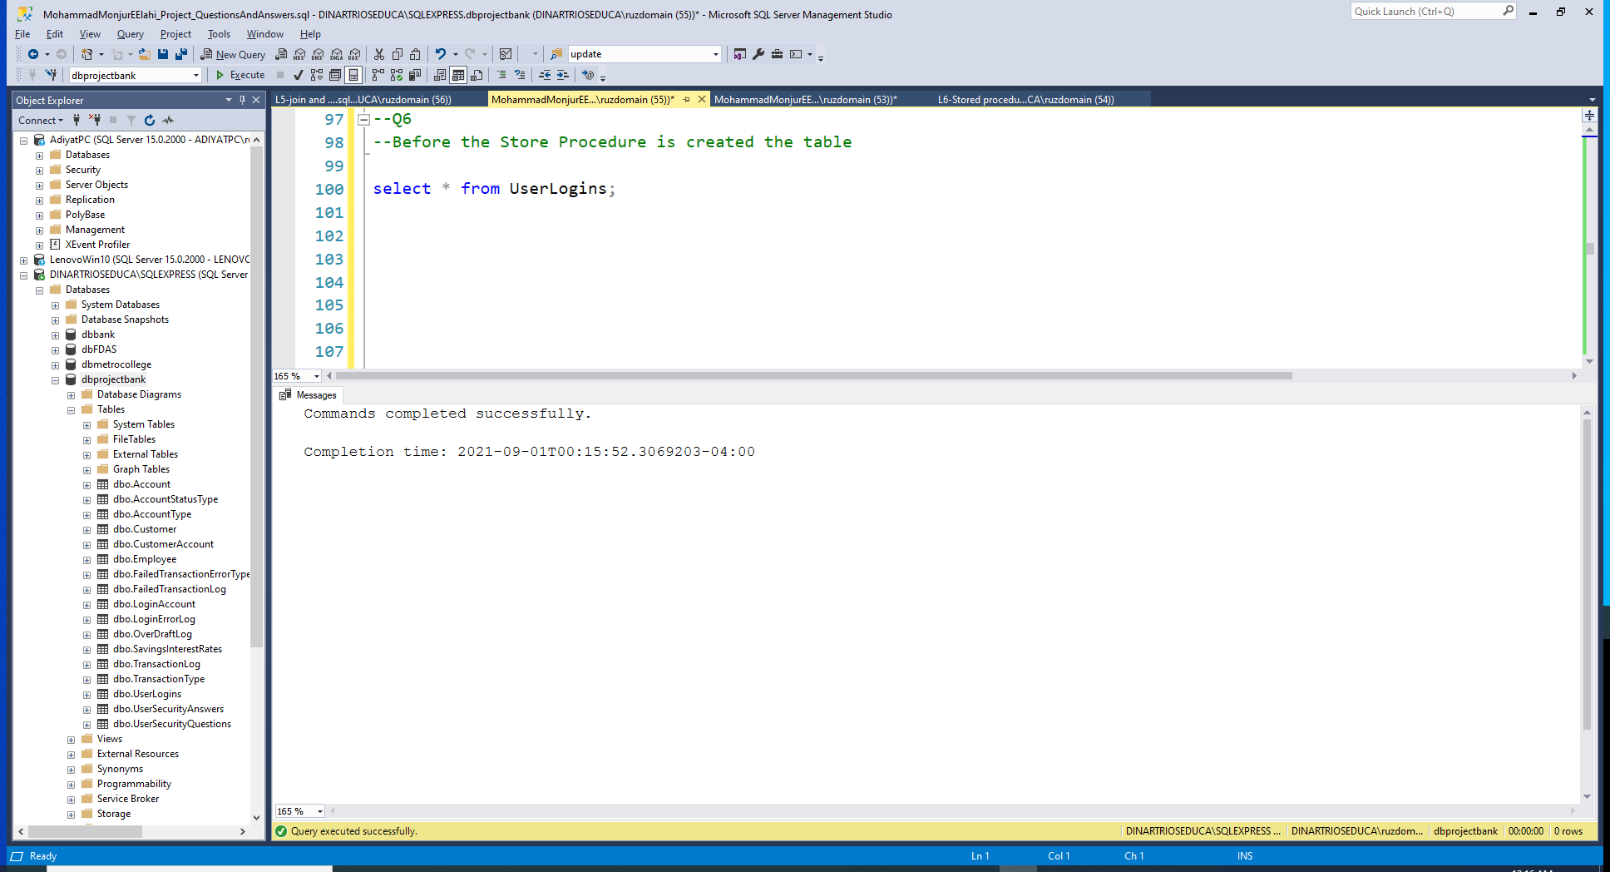

Slide 32
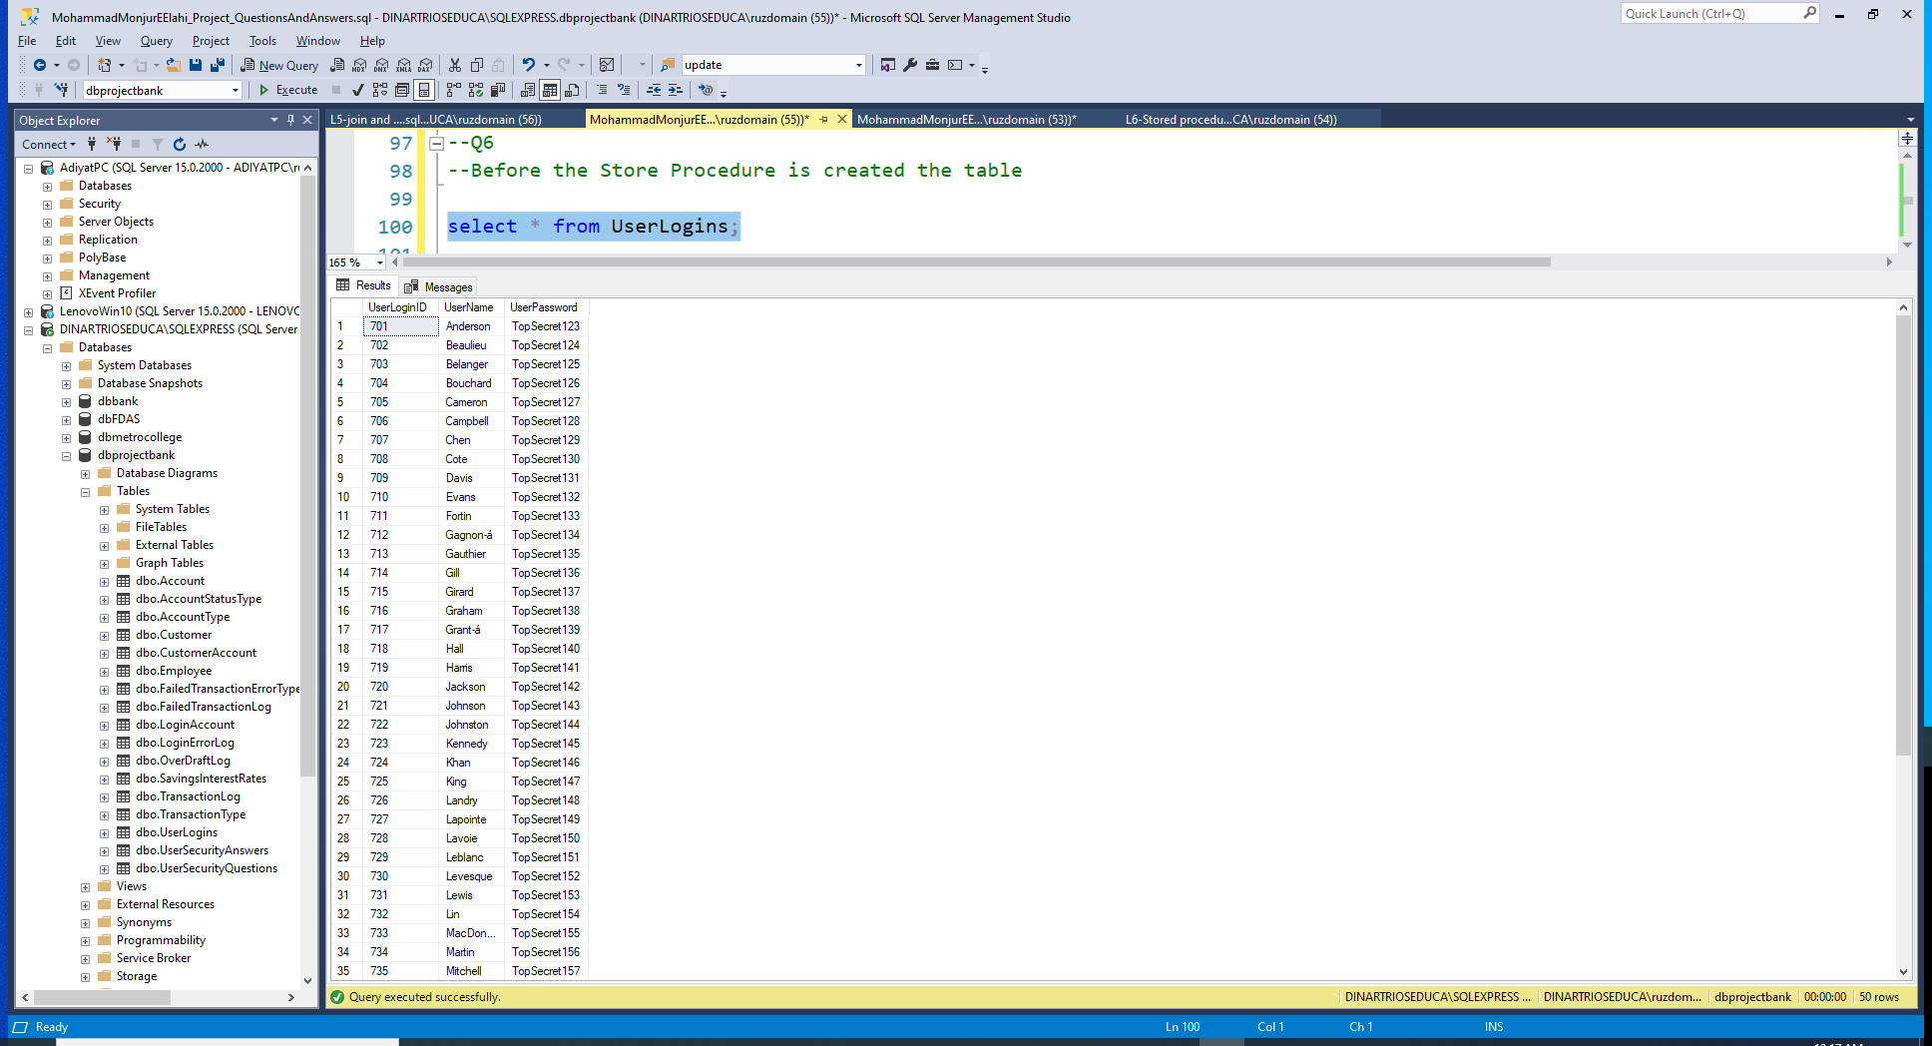
Before Executing the Store Procedure

Slide 33
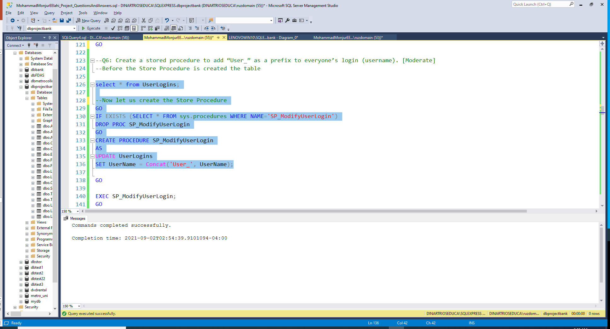

Slide 34
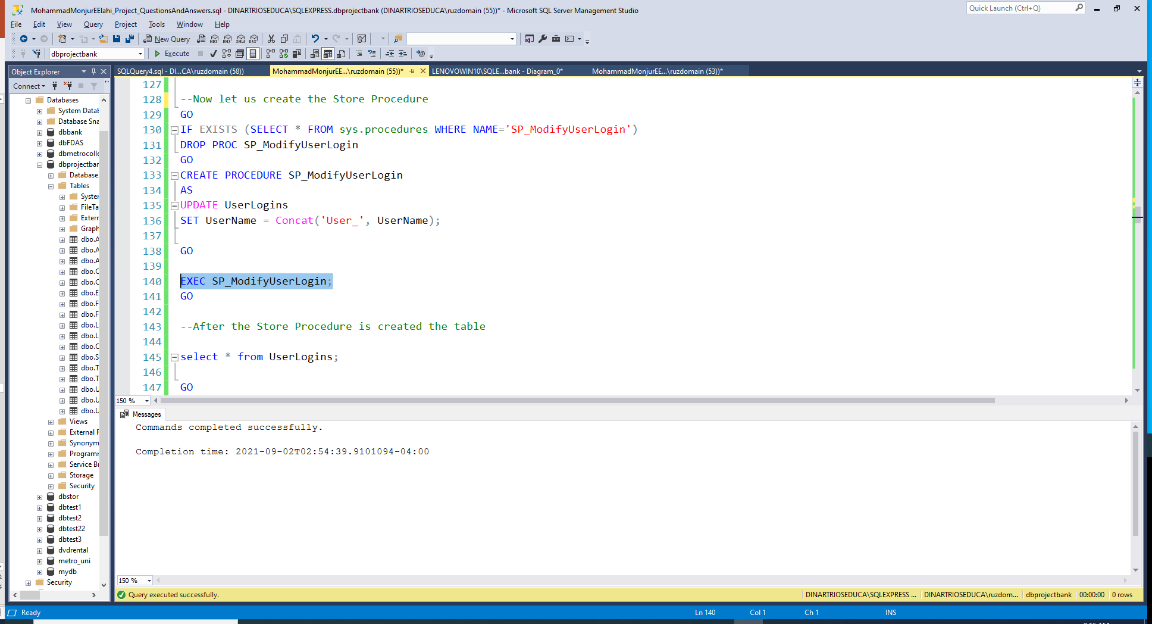

Slide 35
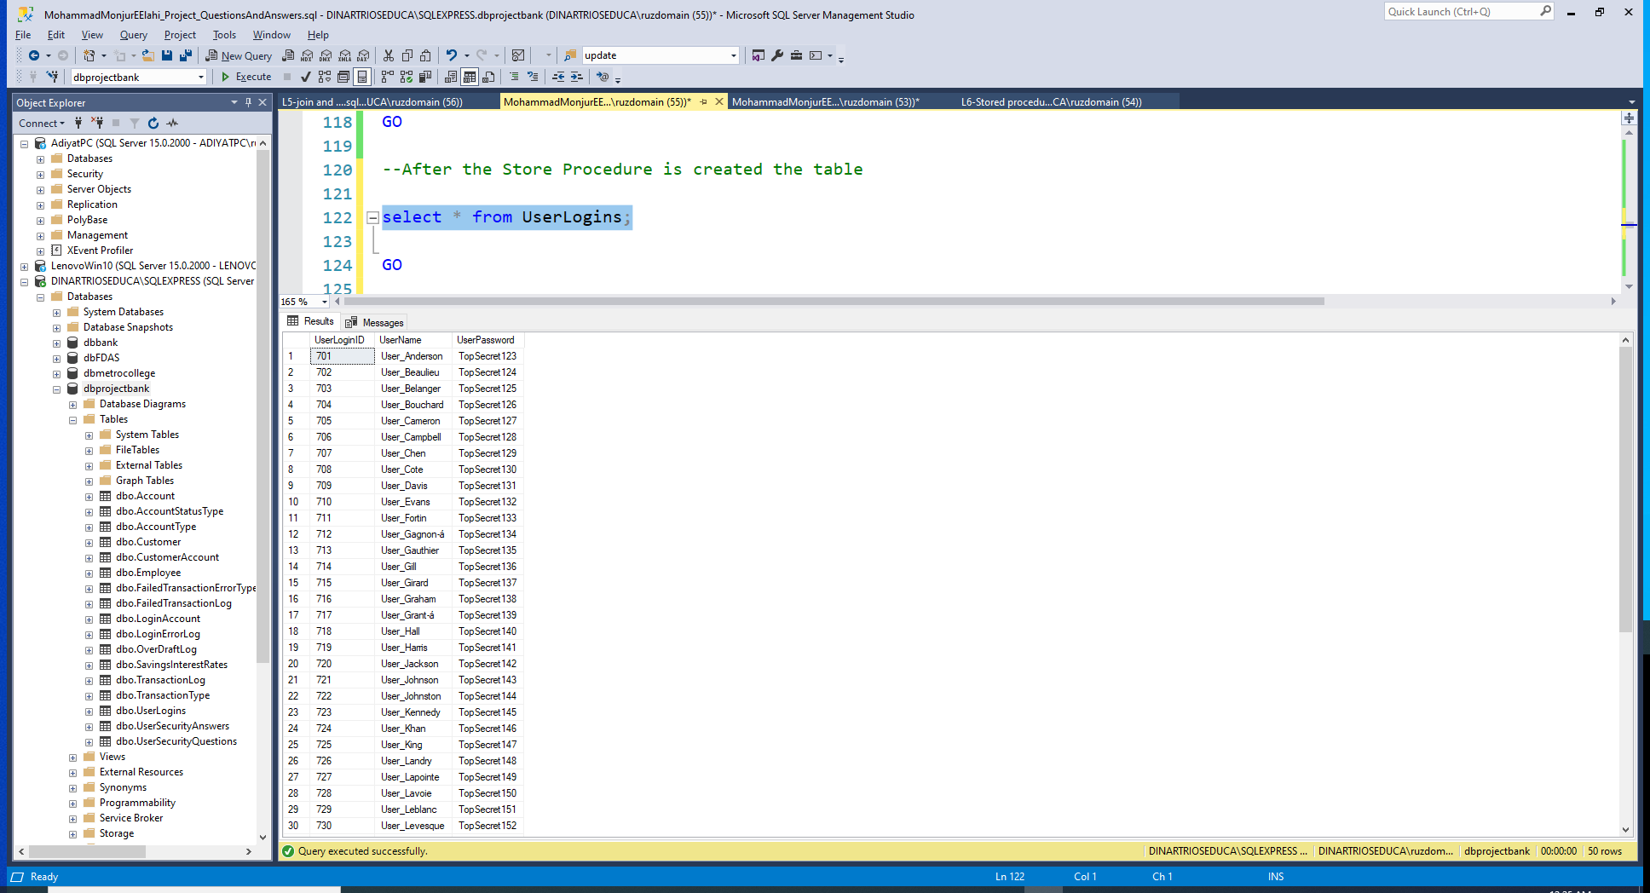
After Executing the Store Procedure
LIST

Slide 36
Phase 02: Q07
Create a stored procedure that accepts AccountId as a parameter and returns customer’s full name. [Advanced]
LIST

Slide 37
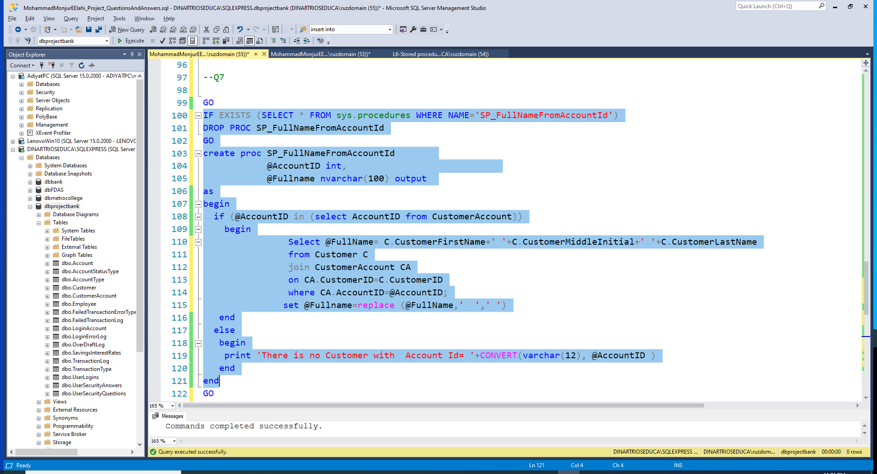

Slide 38
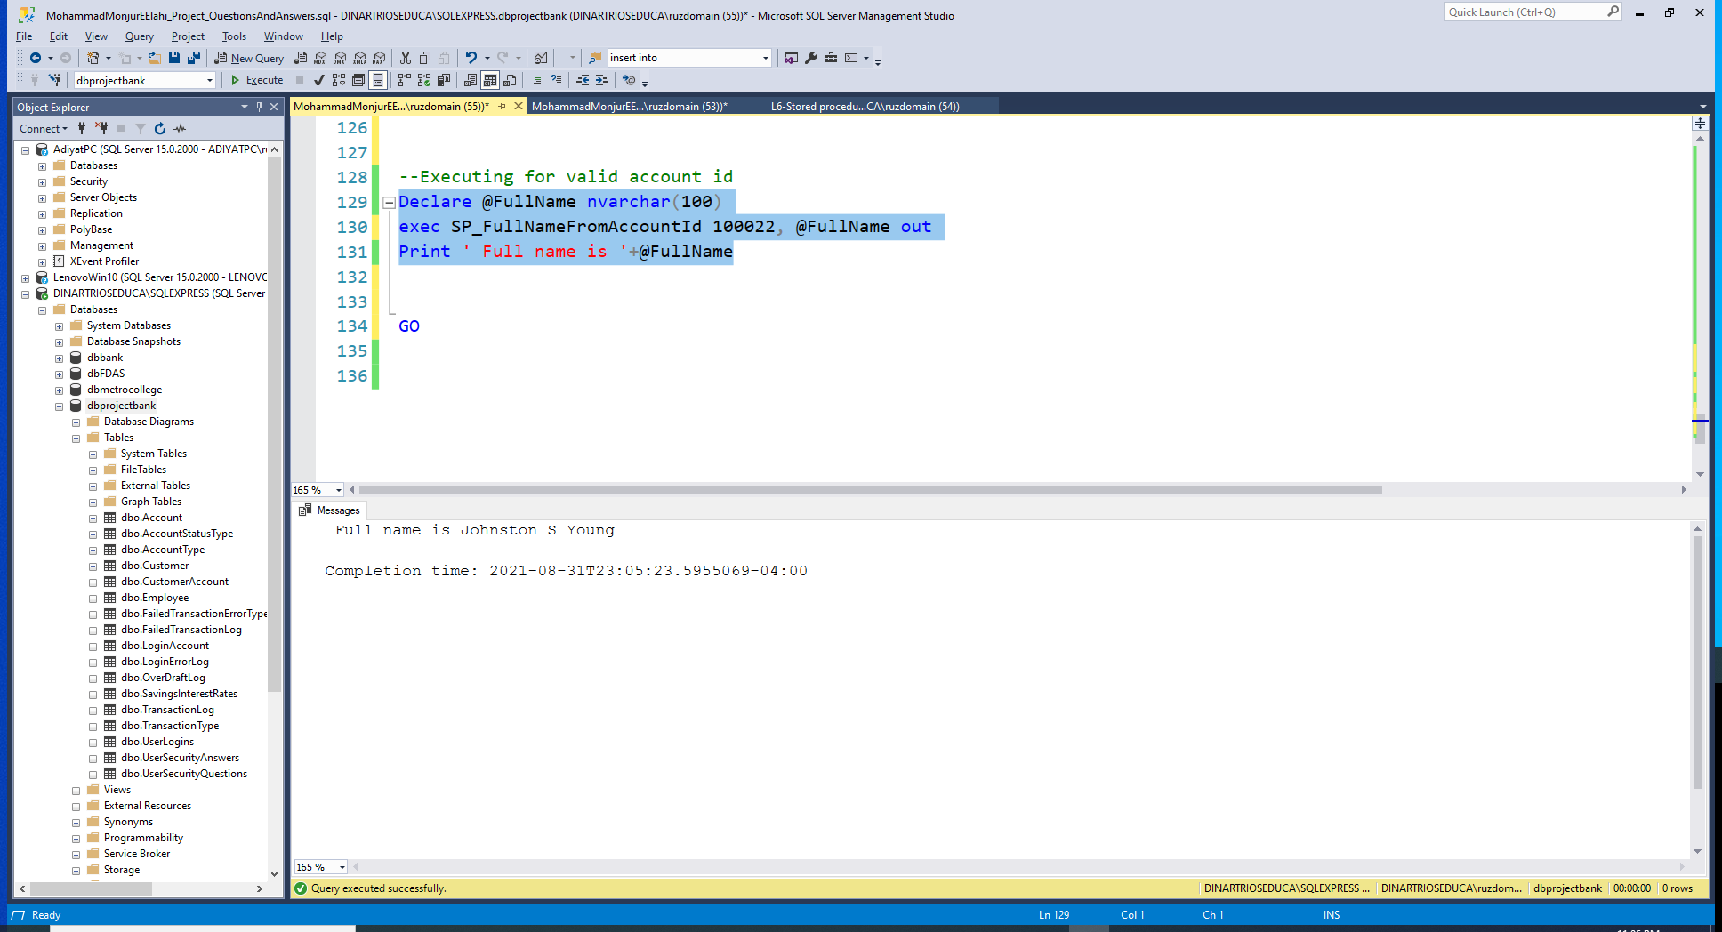
Using a valid Account ID

Slide 39

Using an invalid Account ID
LIST

Slide 40
Phase 02: Q08
Create a stored procedure that returns error logs inserted in the last 24 hours. [Advanced]
LIST

Slide 41
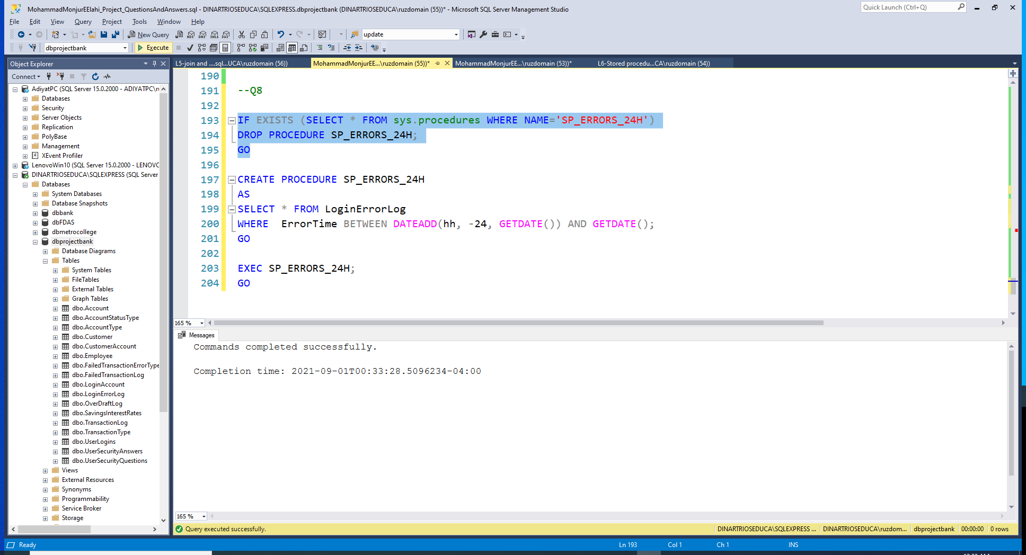

Slide 42
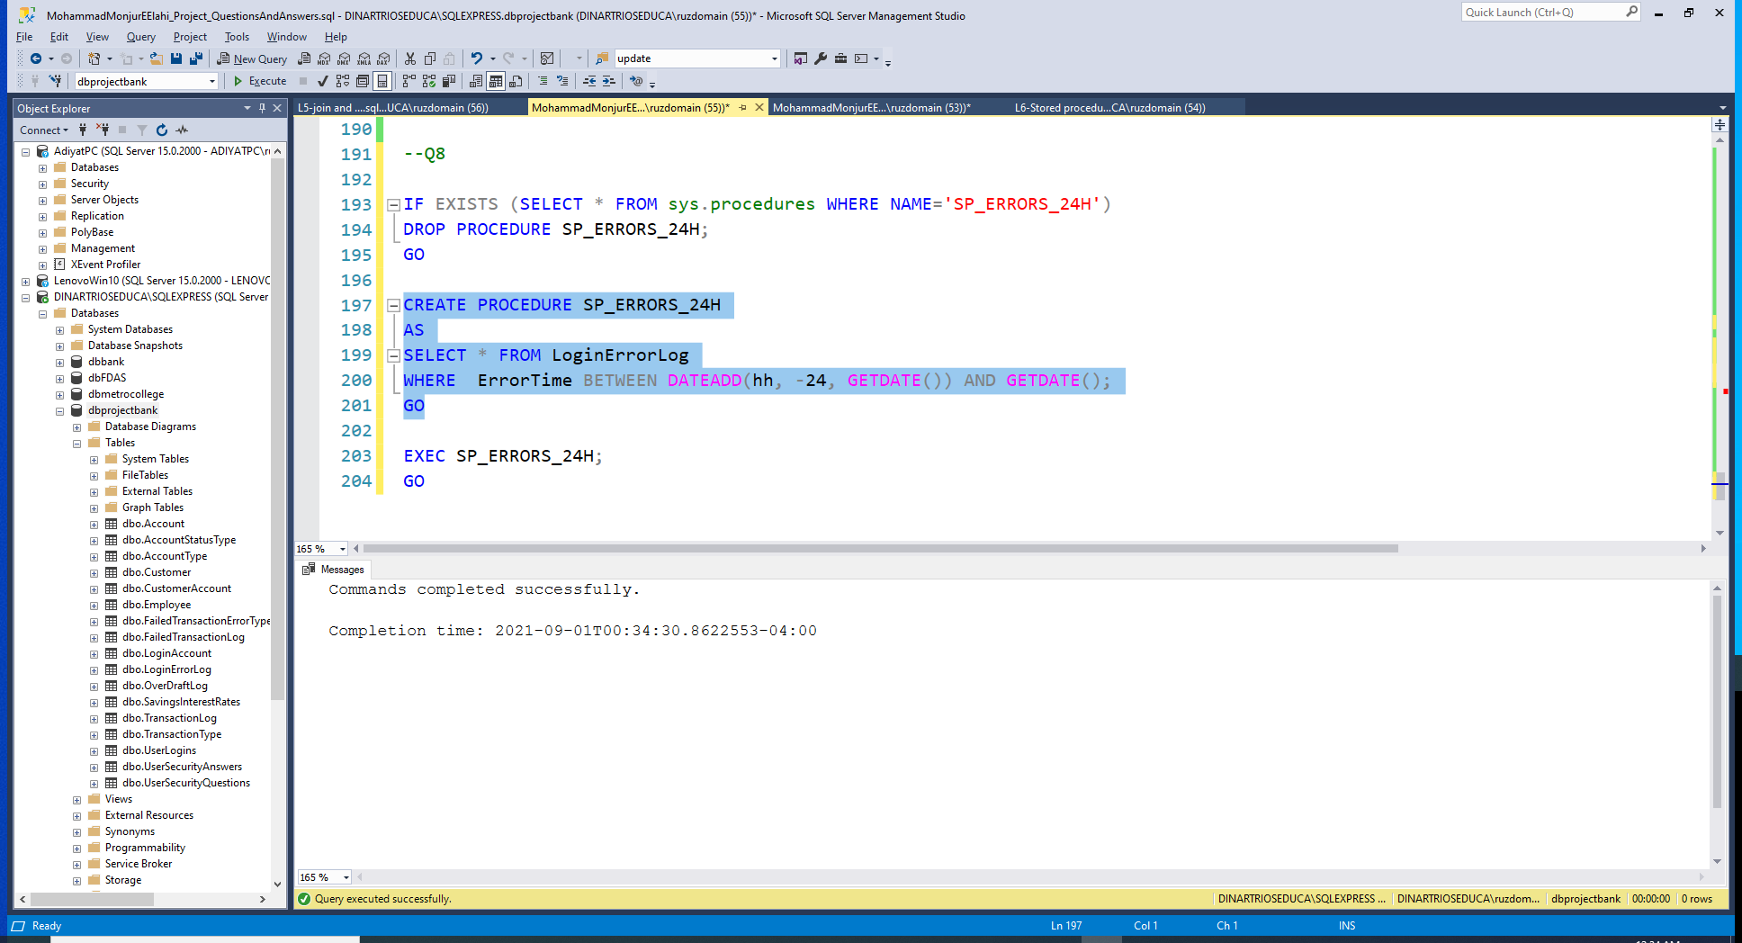

Slide 43
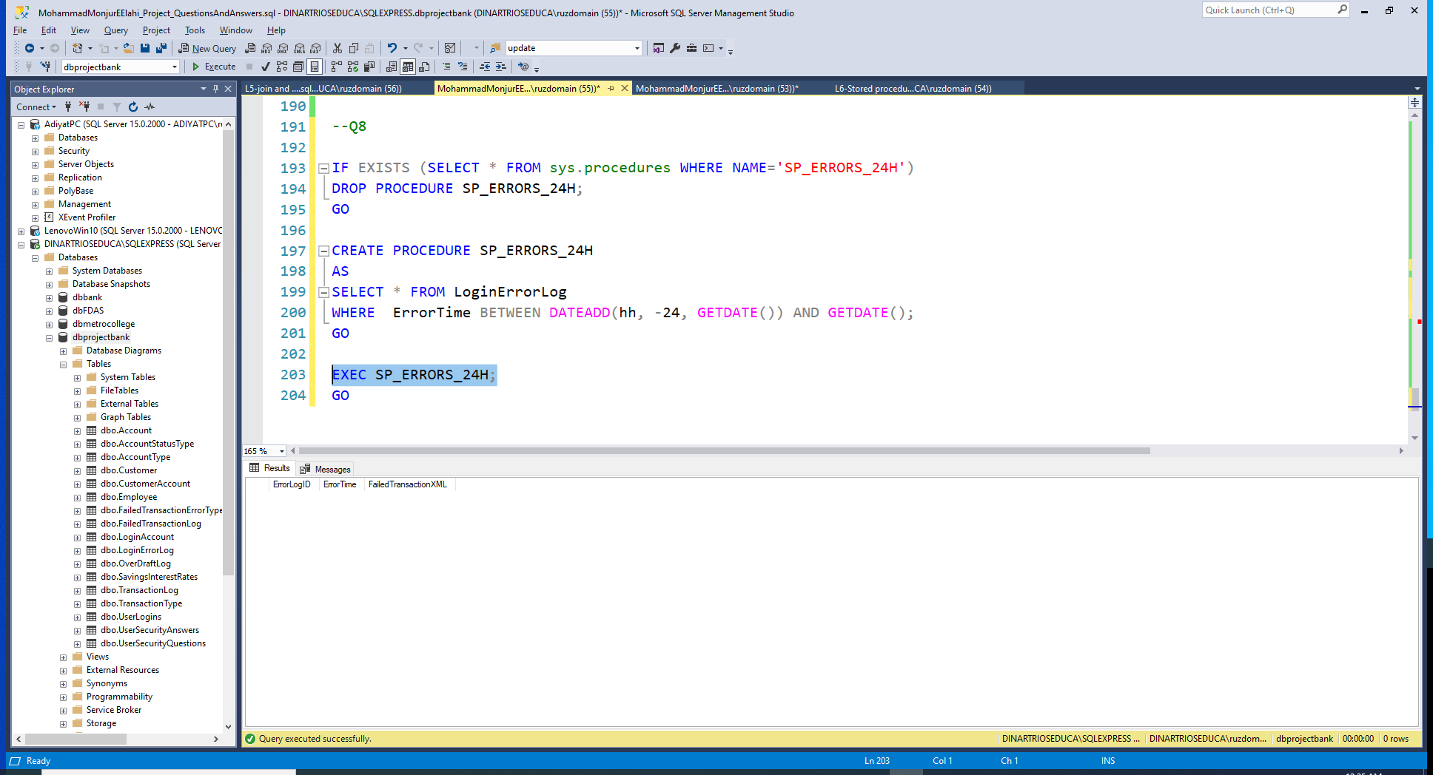
Errors in my table are not that recent!!

Slide 44
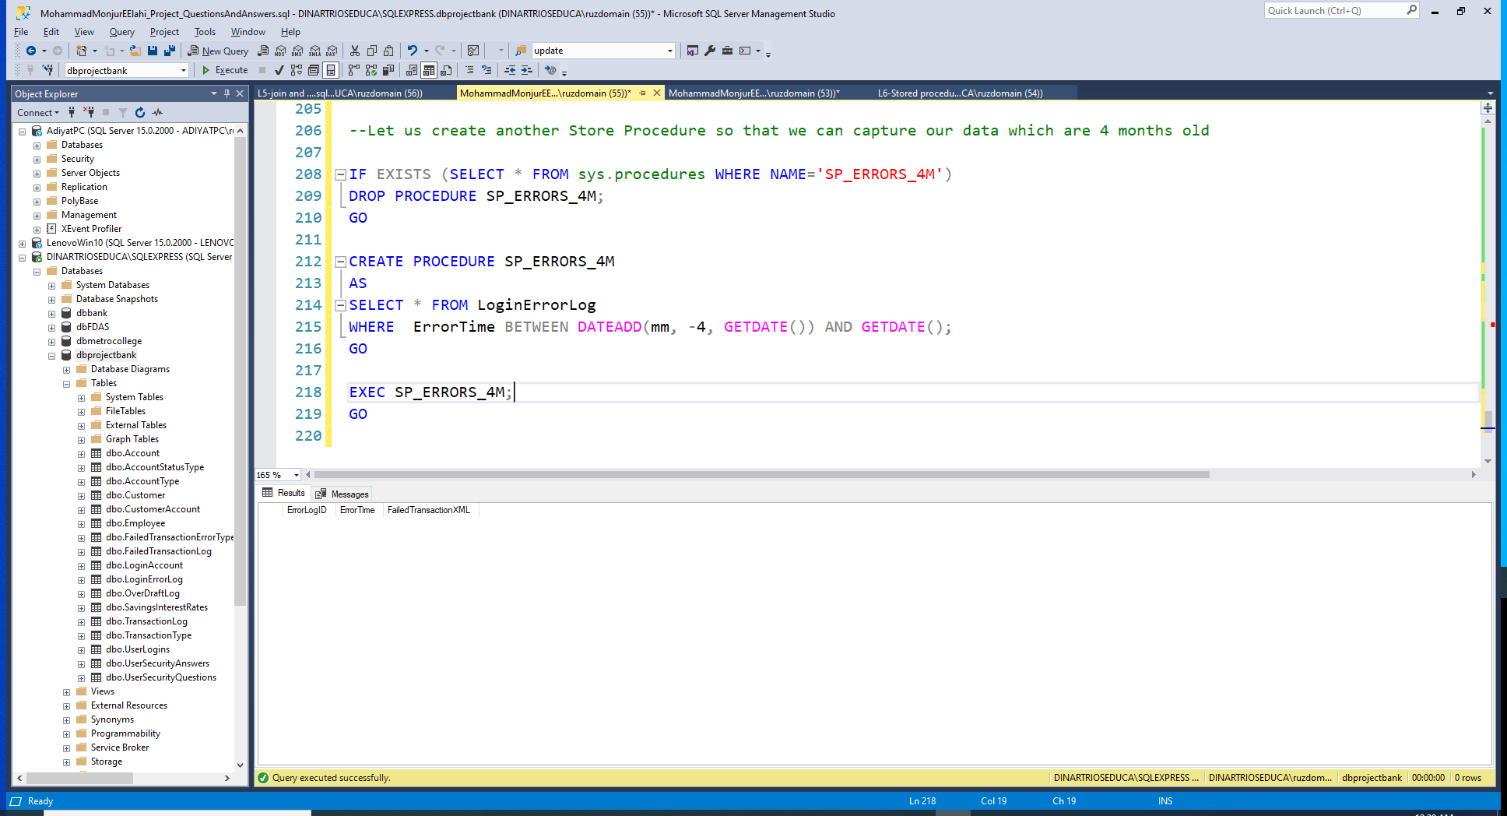

Slide 45
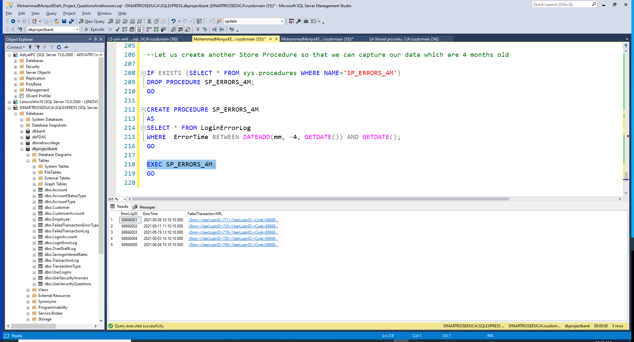
Changed the timeline to 4 months to get an output
LIST

Slide 46
Phase 02: Q09
Create a stored procedure that takes a deposit as a parameter and updates CurrentBalance value for that particular account. [Advanced]
LIST

Slide 47
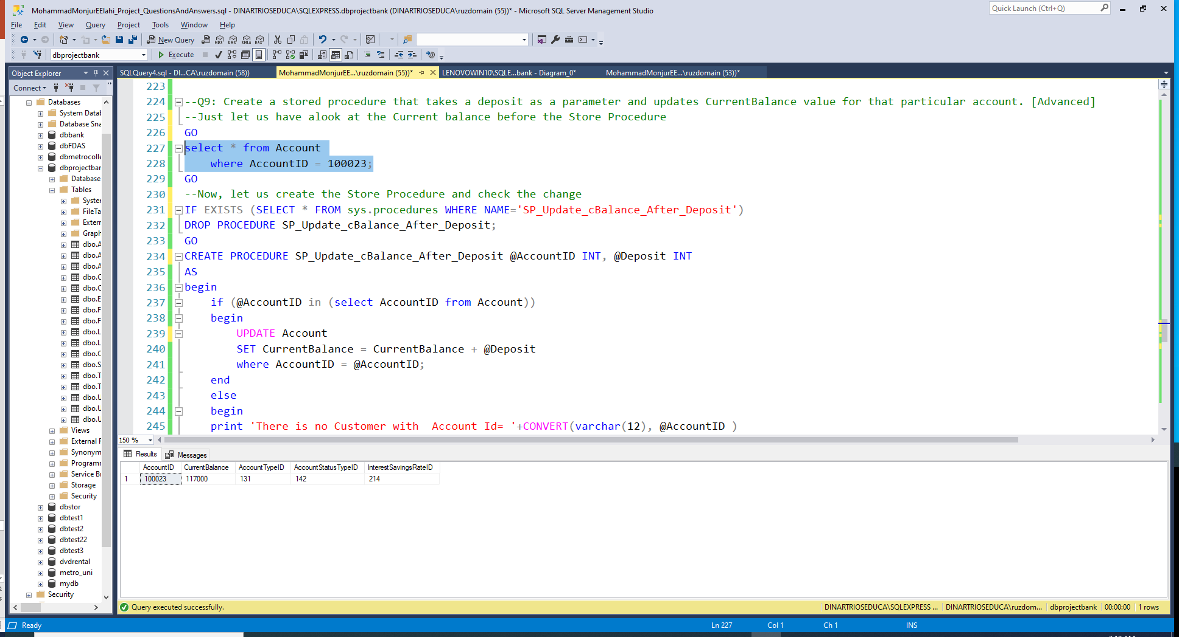
Before the update in the balance

Slide 48
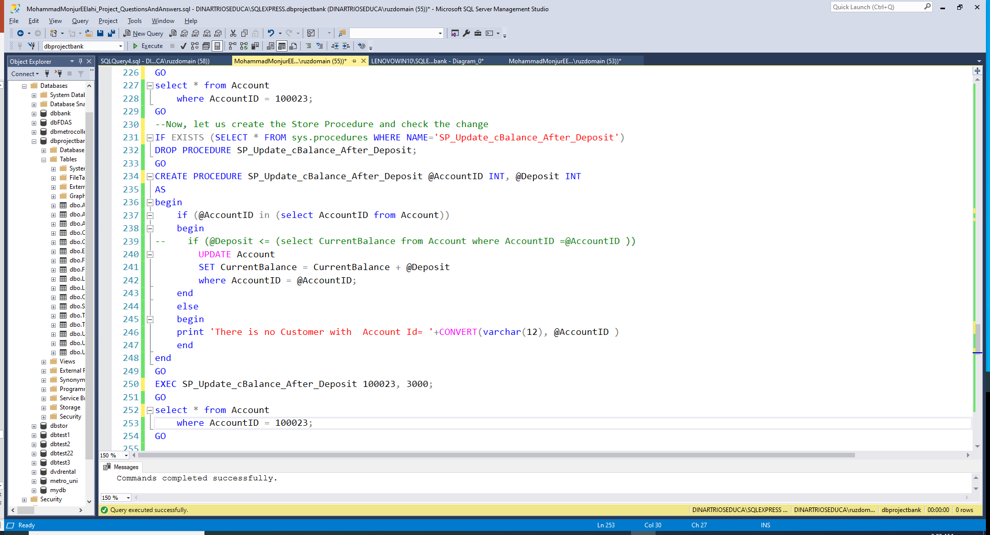

Slide 49
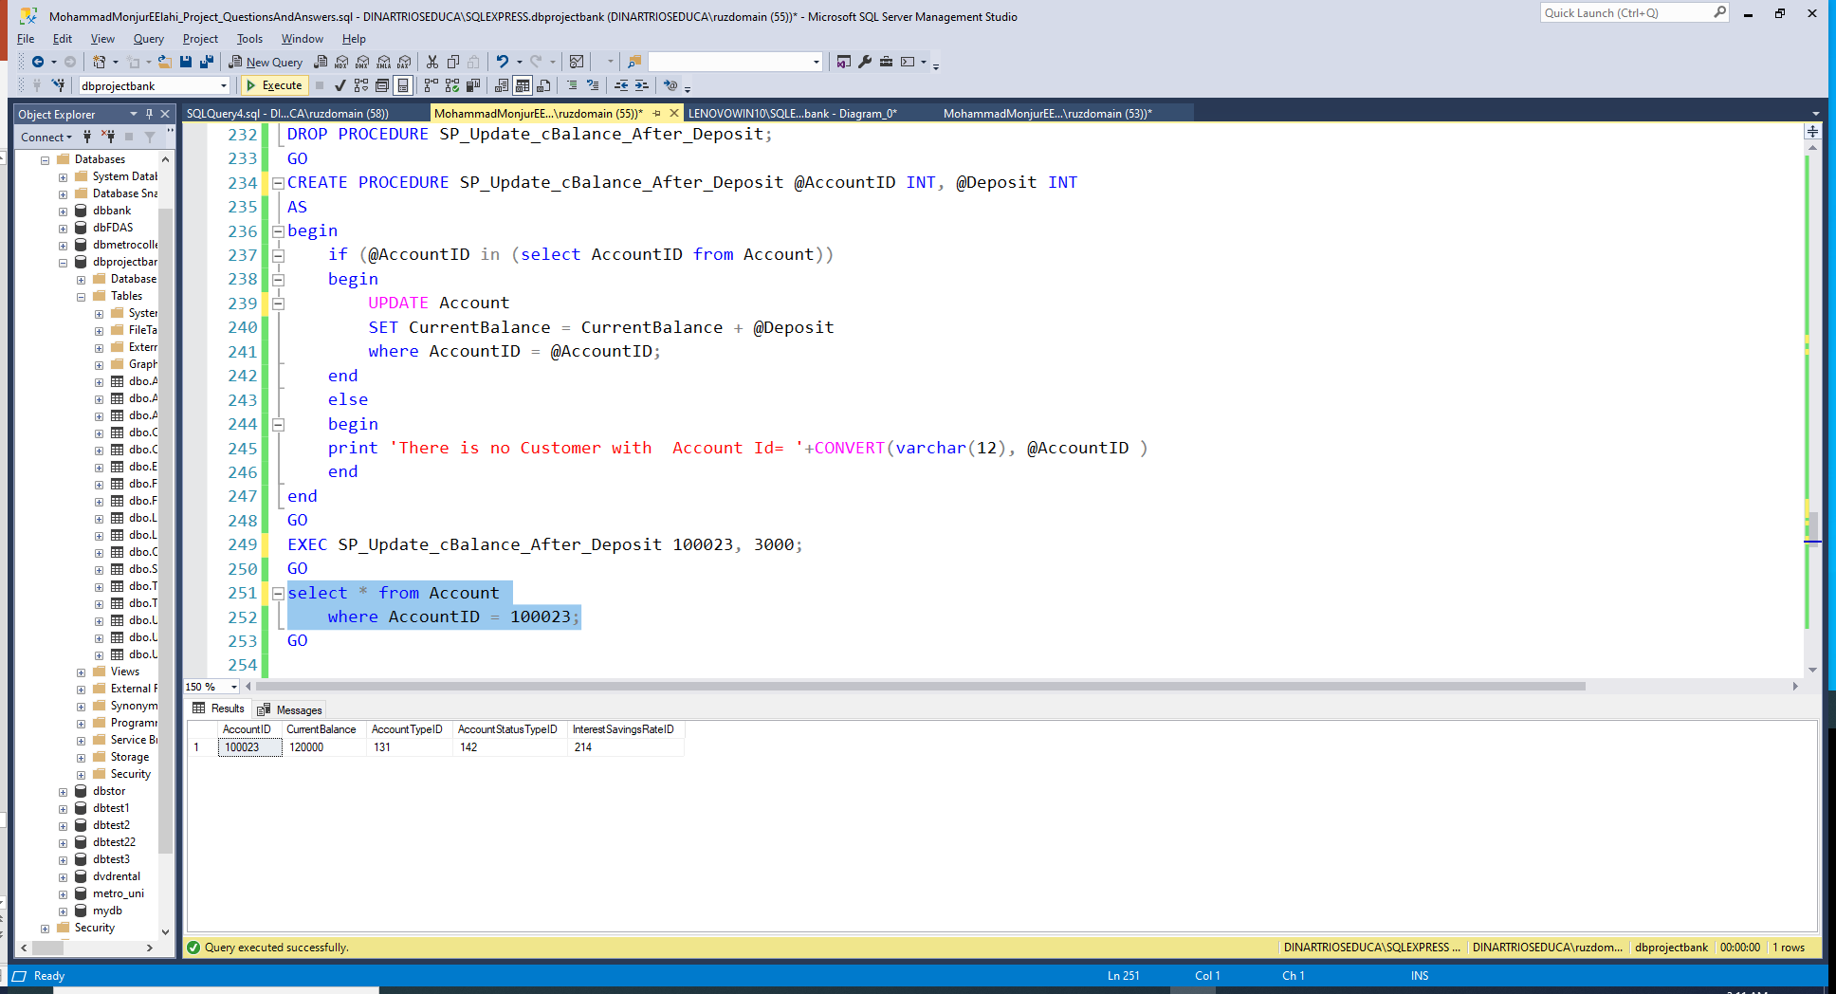
After the update in the balance
LIST

Slide 50
Phase 02: Q10
Create a stored procedure that takes a withdrawal amount as a parameter and updates
LIST

Slide 51
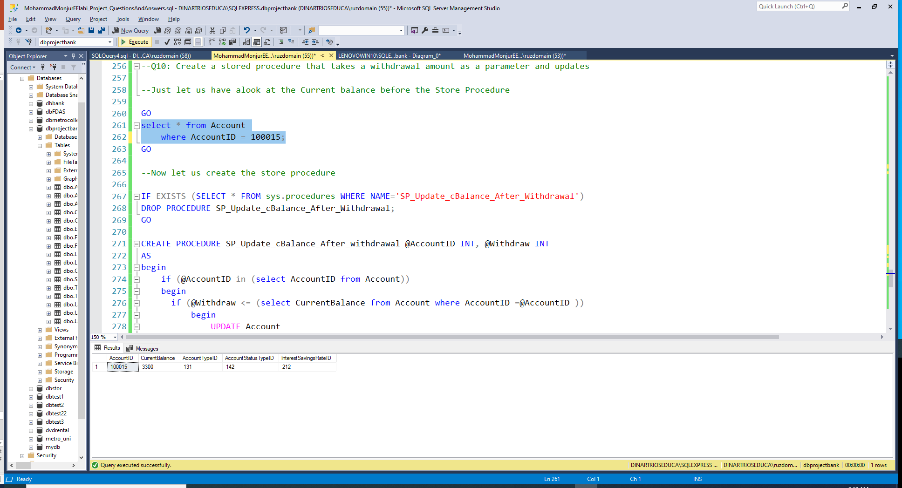
Before the withdrawal

Slide 52
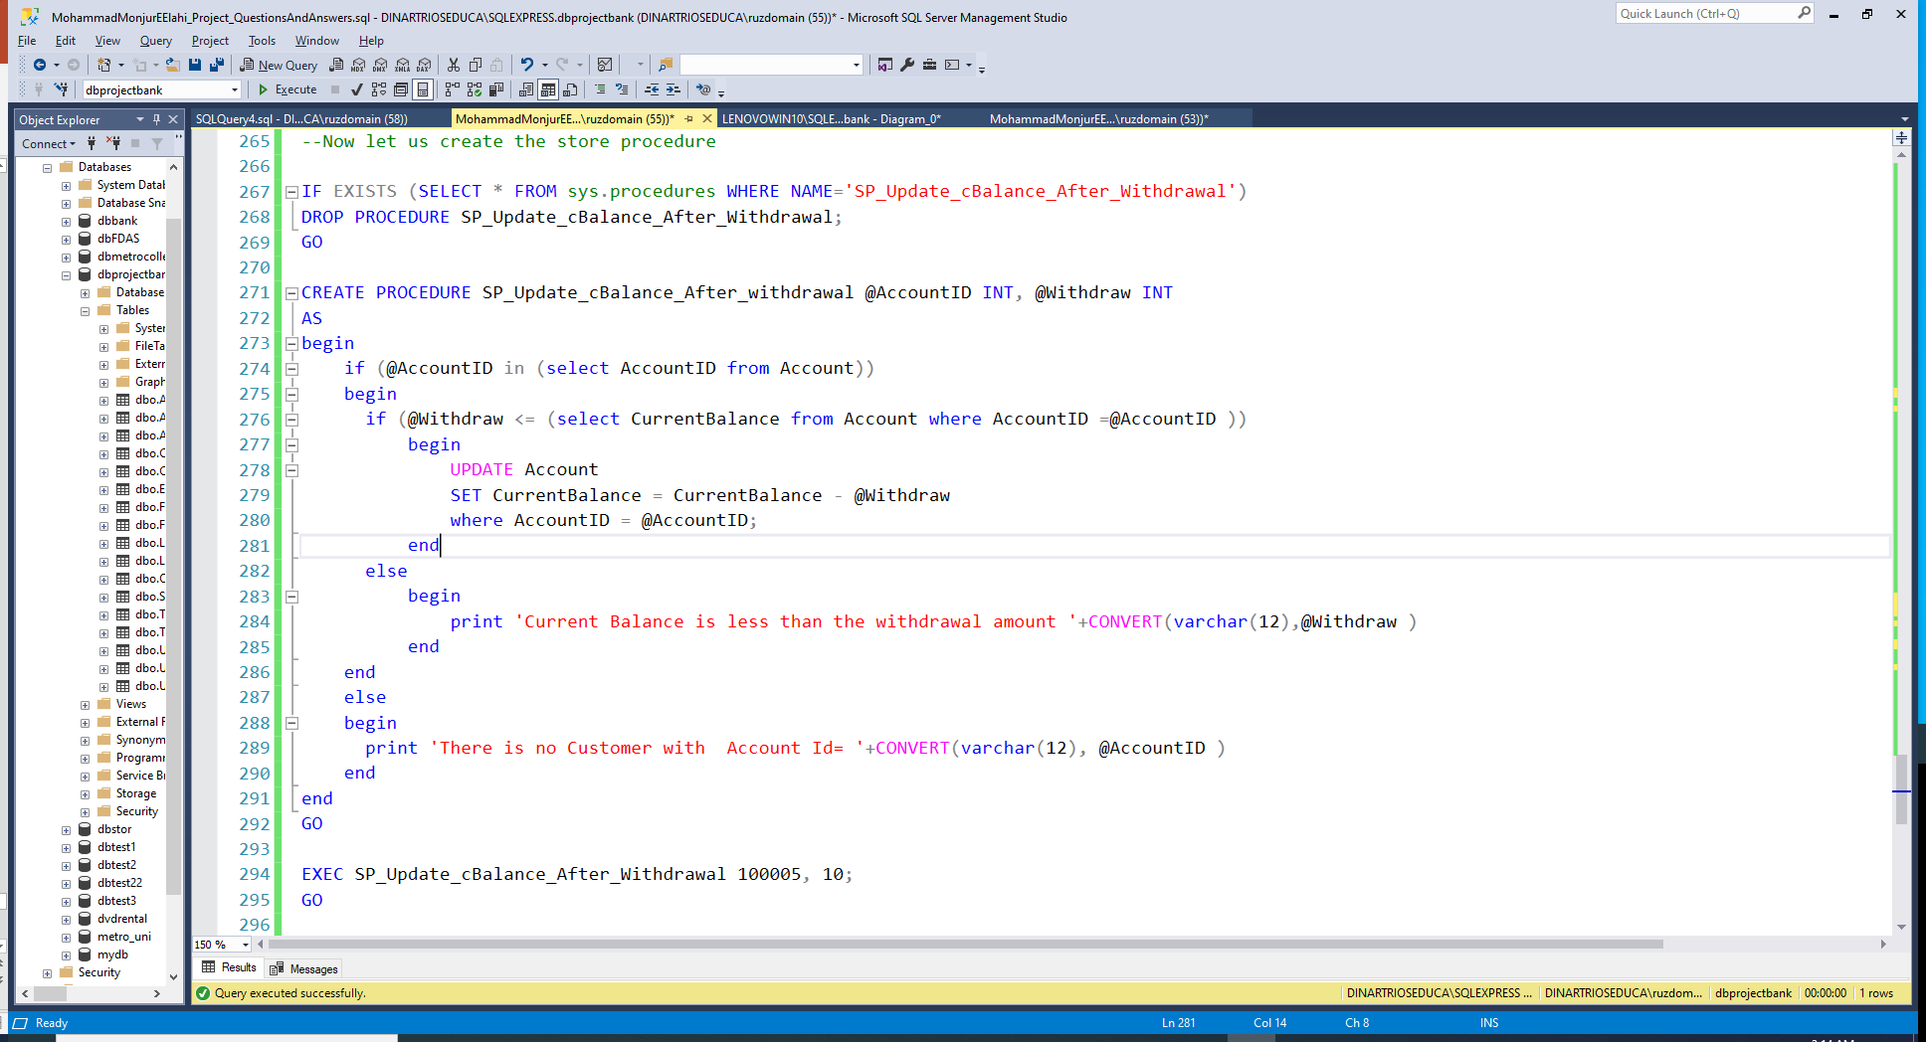

Slide 53
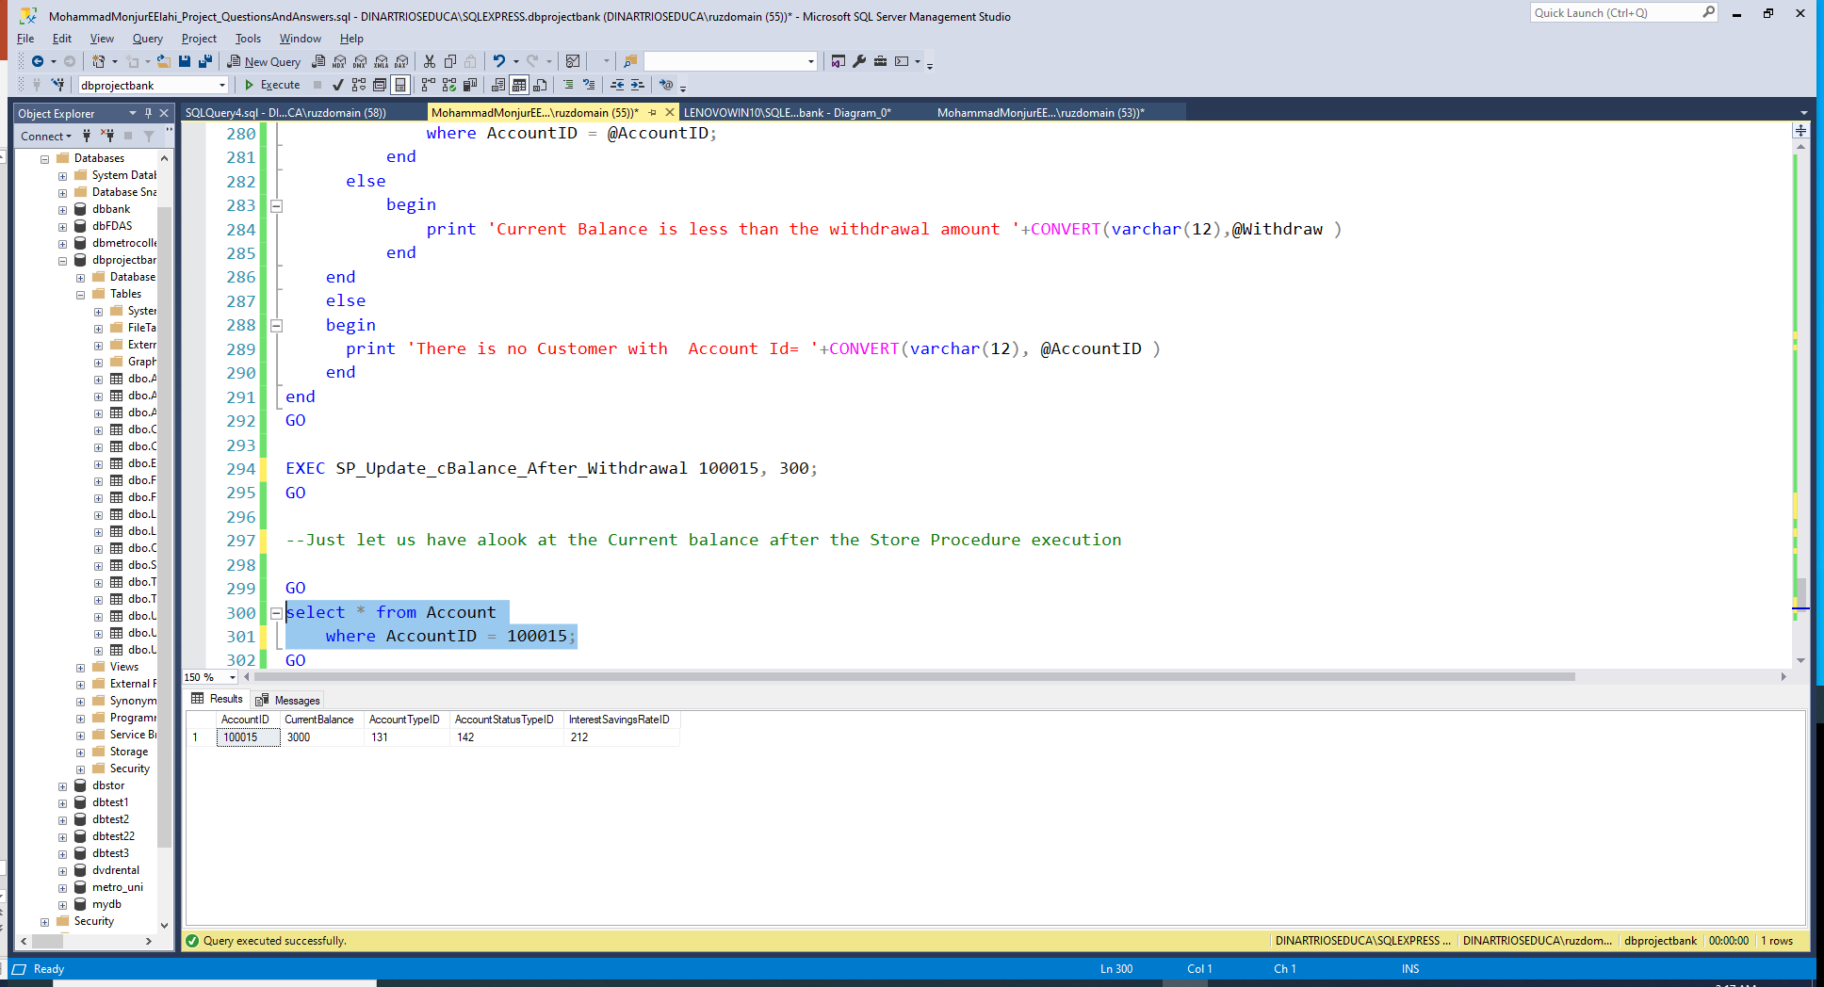
After the withdrawal
LIST

Slide 54
Thanks
Questions ?
LIST

